Slide 1
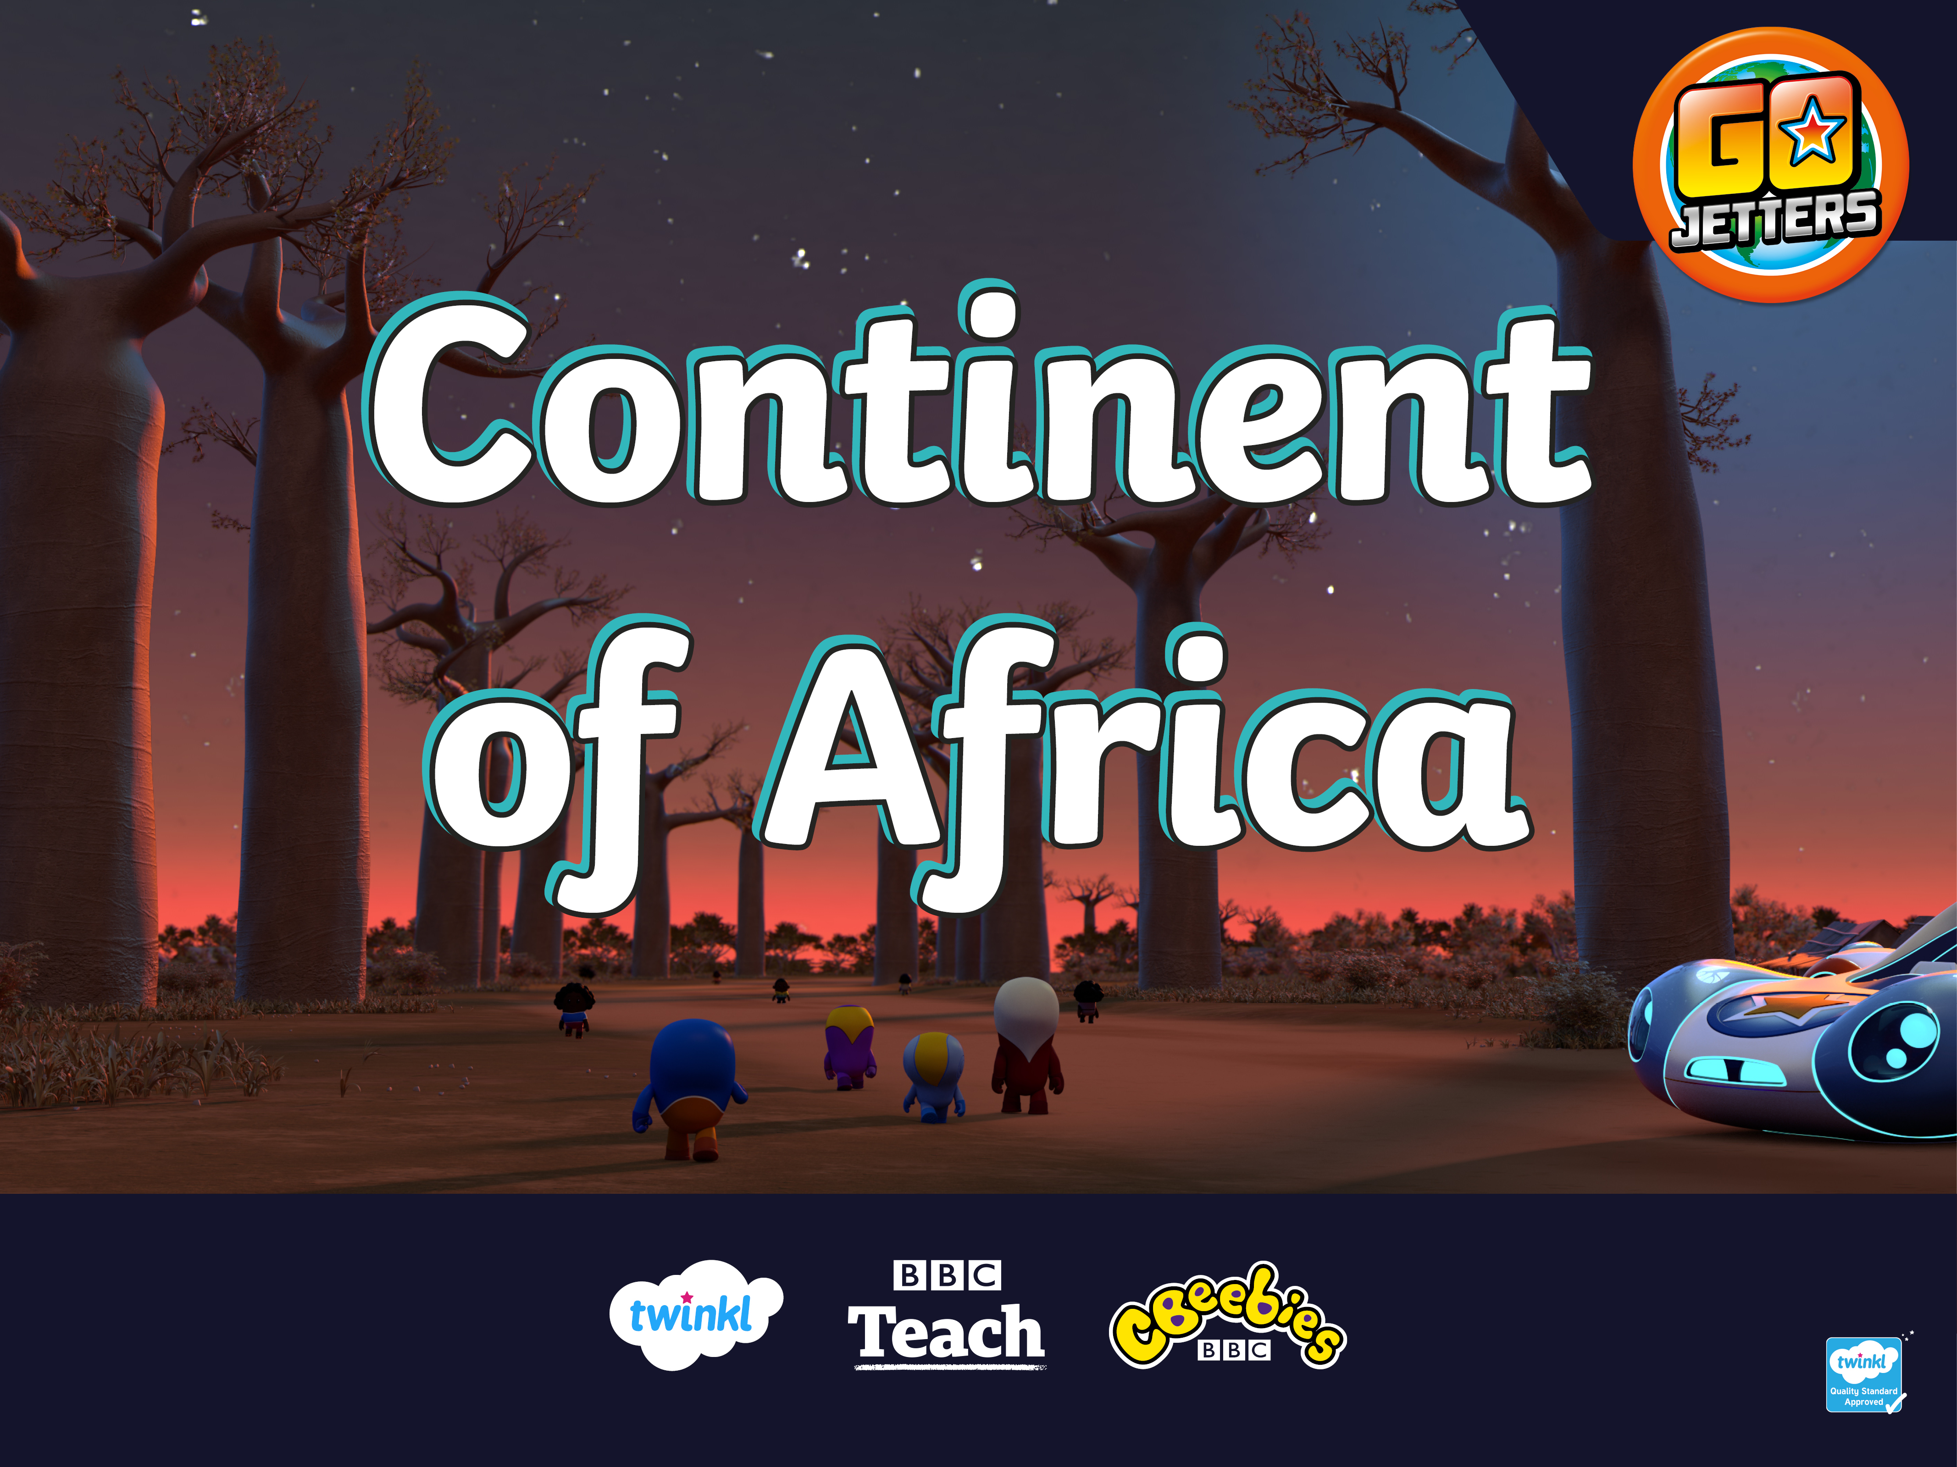

Slide 2
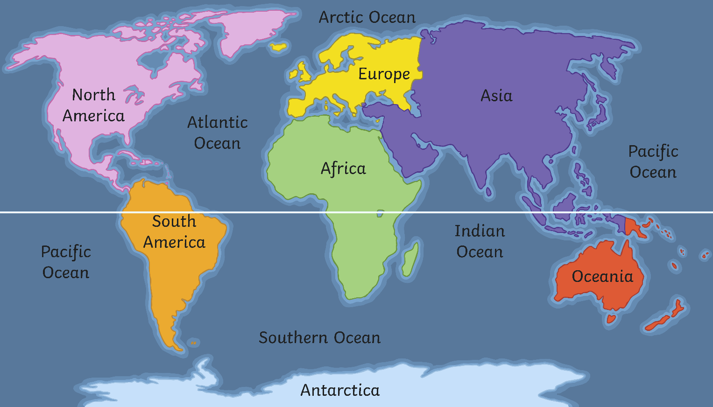
What Is a Continent?
Here are the seven continents of Planet Earth. A continent is a massive piece of land that is often separated from other areas of land by water or another feature such as mountains.
Equator

Slide 3
Africa
Here is a map which shows the countries that are in the continent of Africa. Geographic!

Slide 4
Africa
Today, we are going to be learning about the continent of Africa. Tell your partner anything you already know about Africa.
Here’s Ubercorn with some Funky Facts.

Slide 5
What Is a Landmark?
A landmark is something that stands out in an area. It could be a building, a bridge, a lake or river, a sculpture or something else. These places might be special because of their age or their size.

Slide 6
What Is a Landmark?
A landmark makes a place recognisable. This means you could look at a picture of a landmark and know straight away where it is.

Slide 7
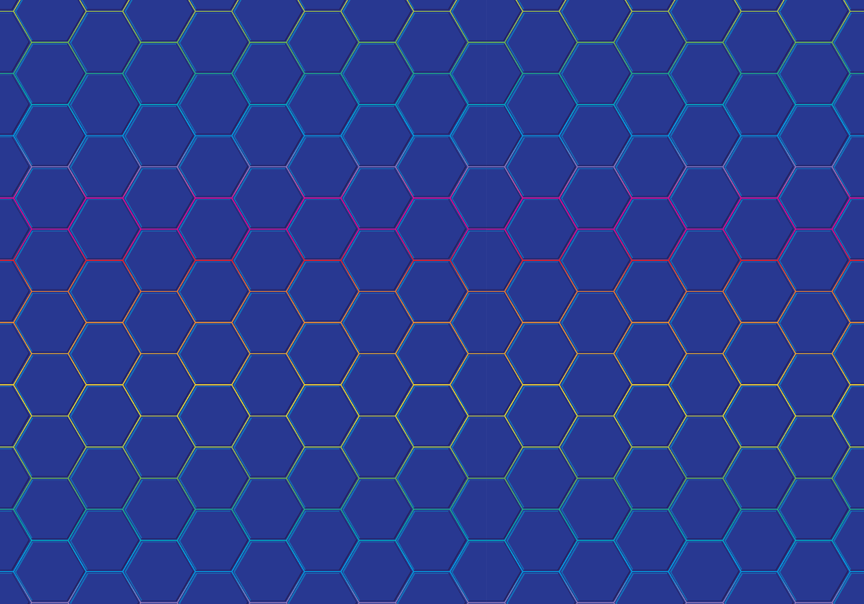
Famous Landmarks
Do you recognise any of these famous landmarks from around the world?

Slide 8
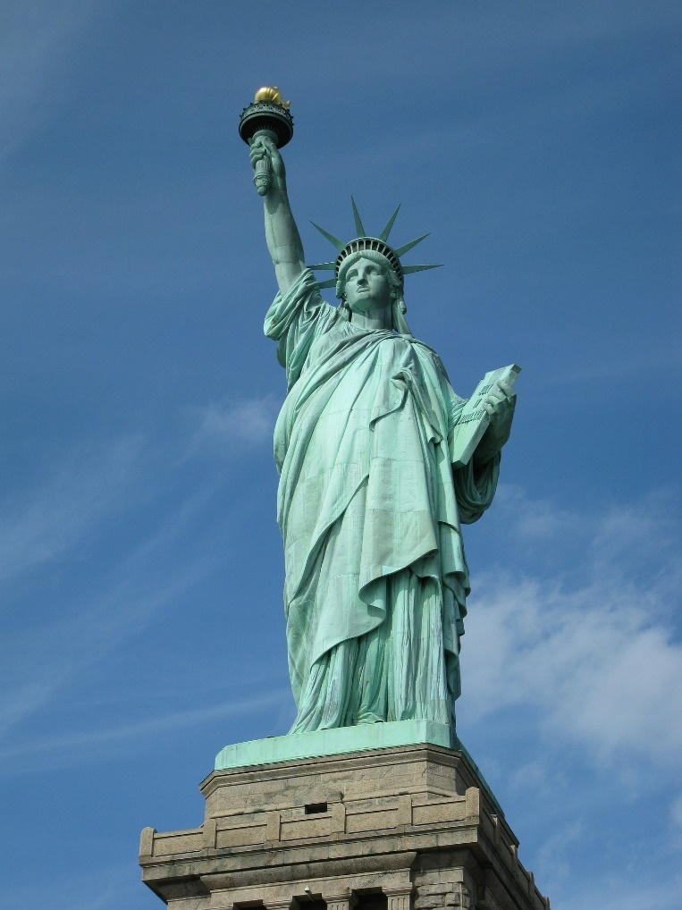
Famous Landmarks
Statue of Liberty, USA

