Slide 2
Match the Rhyming Words
Can you match the rhyming words?
Read the word at the top of the page.
Then, click on the words that rhyme to move them into the middle.

Slide 3




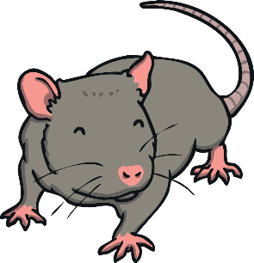

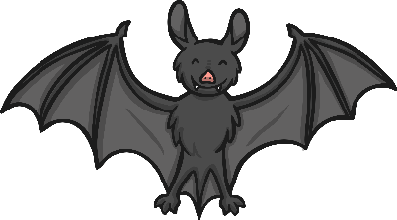
Click the words that rhyme with cat.
back
next
cat
X
hat
pan
X
rat
leg
X
bat
sun

Slide 4
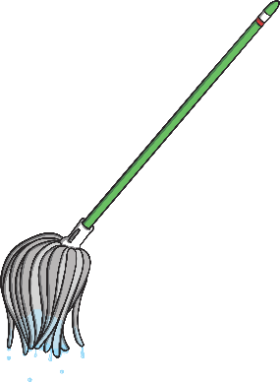

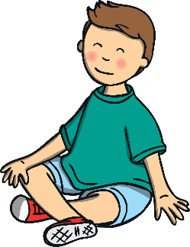

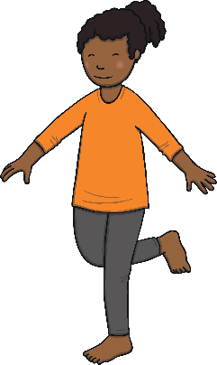

Click the words that rhyme with pop.
back
next
sit
pop
X
mop
X
X
peg
hat
hop
top

Slide 5


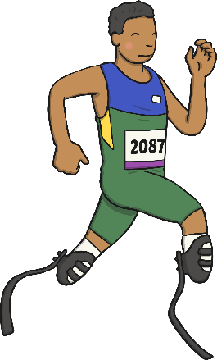






Click the words that rhyme with sun.
back
next
X
sun
cup
run
X
rock
bun
log
X
fun

Slide 6






Click the words that rhyme with rock.
back
next
X
rock
pin
lock
X
sock
gift
X
cup
clock

Slide 7

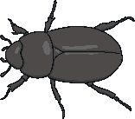


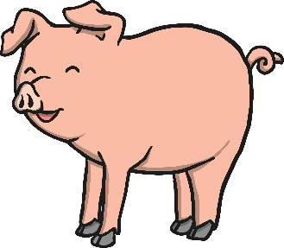


Click the words that rhyme with bug.
back
next
mug
sad
X
bug
X
X
pig
neck
hug
rug

Slide 8




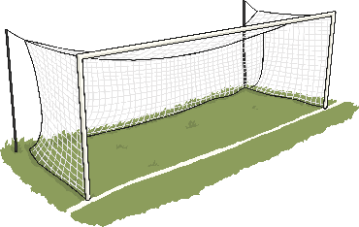

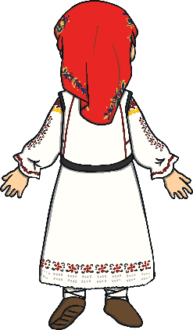
Click the words that rhyme with pet.
back
next
X
pet
jet
pot
can
X
net
X
back
vet

Slide 9
Spot the Odd One Out
back
next
Now, can you spot the word that doesn’t rhyme with the others?
Read the word at the top of the page.
Then, click on the word that doesn’t rhyme to make it fly away.

Slide 10

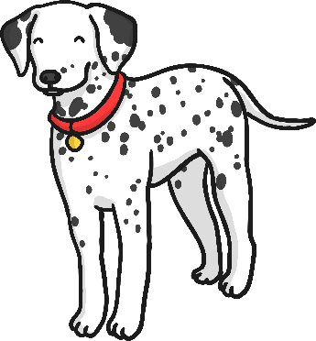
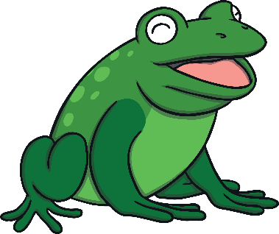

Click the word that does not rhyme with log.
back
next
log
dog
frog
hiss

Slide 11


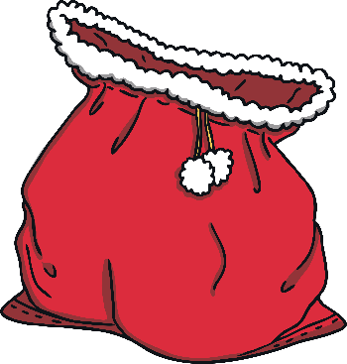
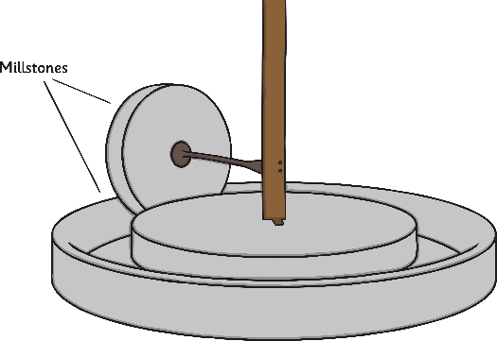
Click the word that does not rhyme with till.
back
next
till
hill
sack
mill

Slide 12

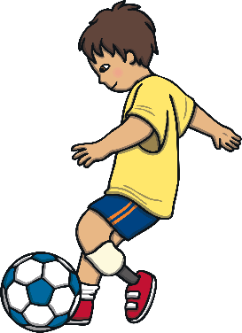
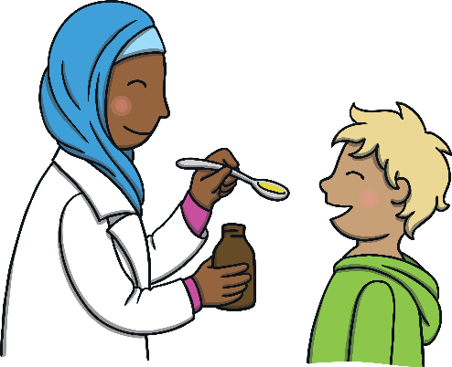
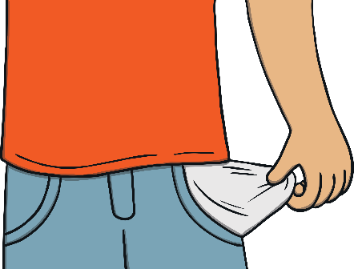
Click the word that does not rhyme with tick.
back
next
tick
kick
sick
pocket

Slide 13
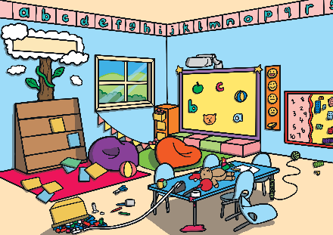
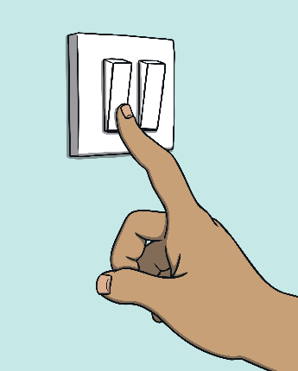
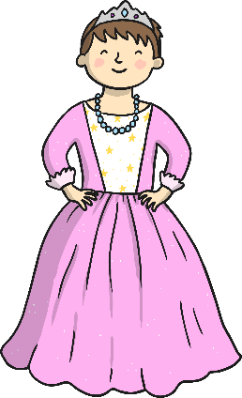
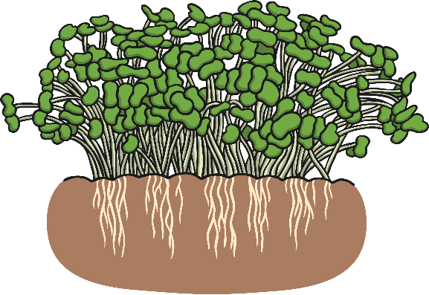
Click the word that does not rhyme with mess.
back
next
mess
off
cress
dress

Slide 14
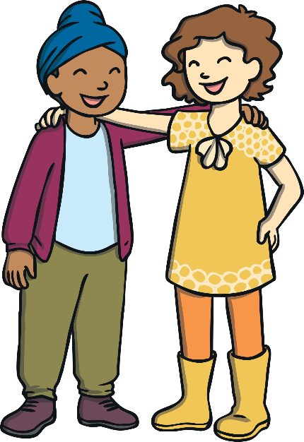

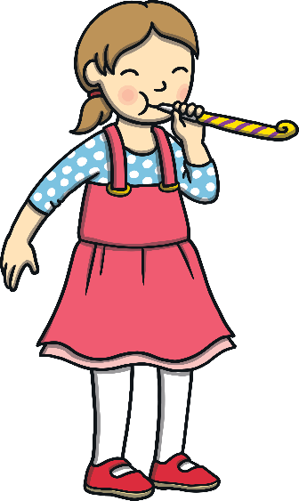
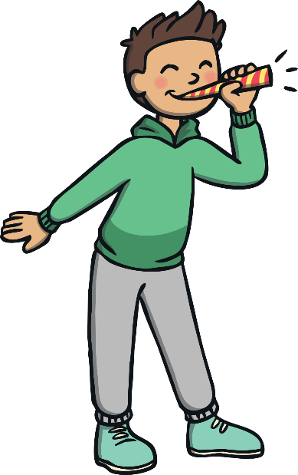
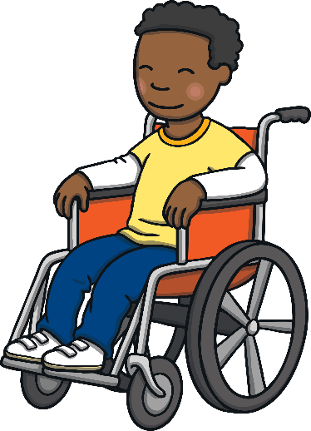
Well Done!
You are a rhyming superstar!

