Slide 1
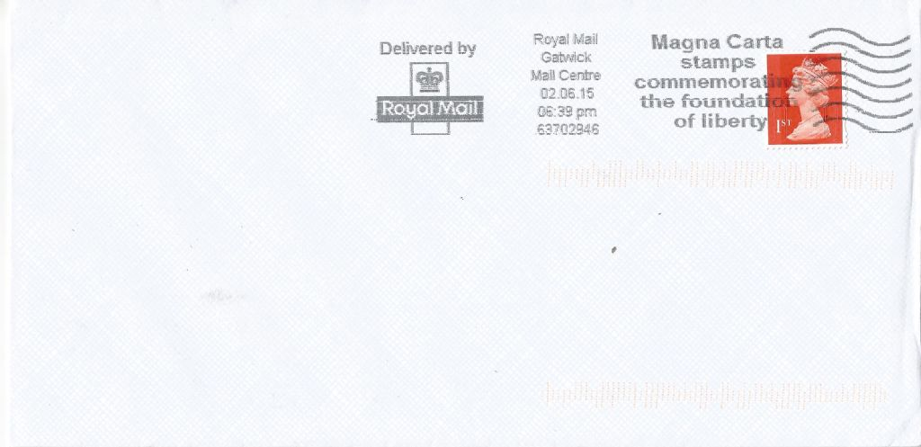
Room Five and Six
Primary Three
Victoria Park Primary School,
Belfast

Slide 2
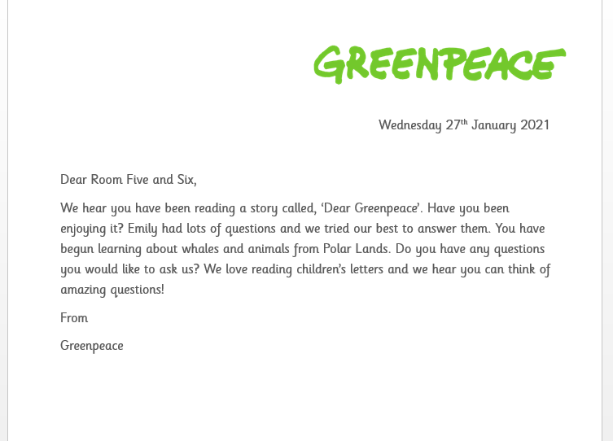

Slide 3
If you were going to write a letter to Greenpeace, what questions would you like to ask?
Can you write these questions in full sentences with capital letters and question marks? You don’t need to write them in the form of a letter. We are just preparing!
Some ideas…
What animals do you help?
What places do you go to?
Is it fun?
Do you work with a lot of people?

