Slide 1

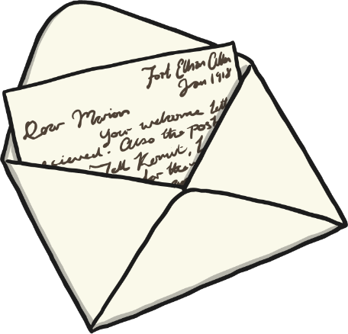
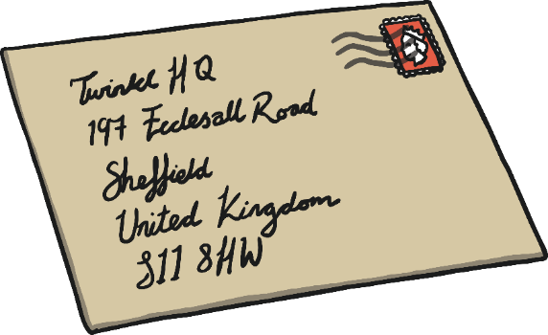
Letter Writing

Slide 2
Why are Letters Important?
Have you ever received a letter?
What was the letter about?
Did you keep the letter to share again?
Did you write back and send a reply?

Slide 3
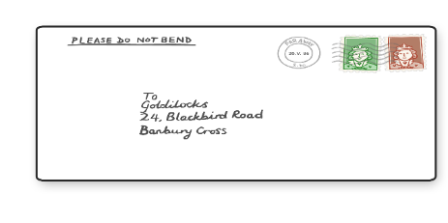

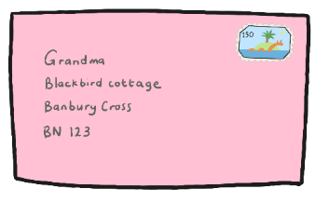
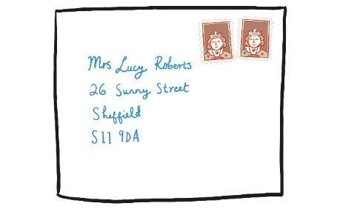

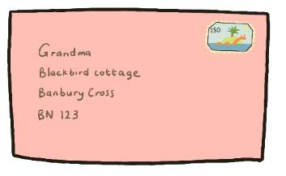


Different Types of Letters
People send letters for many different reasons.
Can you think why you might send or receive a letter?
To say,
“thank you.”
Susie Brown
2 Sally Street
Darwin, NT
0800
Dolly
99 Letter Street
Darwin, NT
0800
To complain
To make appointments
Lucy Roberts
34 Woods Street
Darwin, NT
0800
To write to friends or family
George Shaw
16 Ward Street
Darwin, NT
0800
To give or receive information
To send a postcard telling someone about your holiday
Teddy
5 Porridge Street
Darwin, NT
0800
Adam West
56 Forest Street
Darwin, NT
0800

Slide 4
We write ‘from’

Slide 5
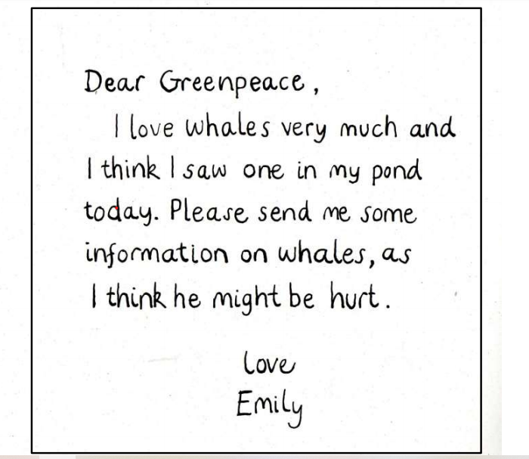
Emily got four out of five! She just forgot the date. She is only learning how to write letters- like us!
Has Emily used these five things?

