Slide 1



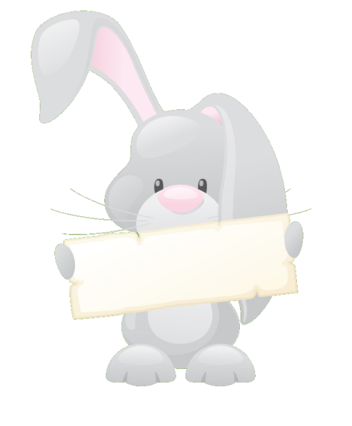


Letters and Sounds
High Frequency Words:
The First 100

Slide 2



Notes for teachers
This presentation uses triggers, motion paths and action buttons. The triggers allow the presentation to be worked through at a pace that suits your needs. Using the choice screen, select your phase. Each slide shows a magician’s hat. Every time to click on the hat a rabbit, holding a word, will jump out. Pupils can then read the word that they see. Clicking the wand will make it disappear and children can try the next word. Click on the example below to see how this works.
.
the

Slide 3
Choose your Phase
Phase 2
Phase 3
Phase 4
Phase 5
Quit

Slide 4

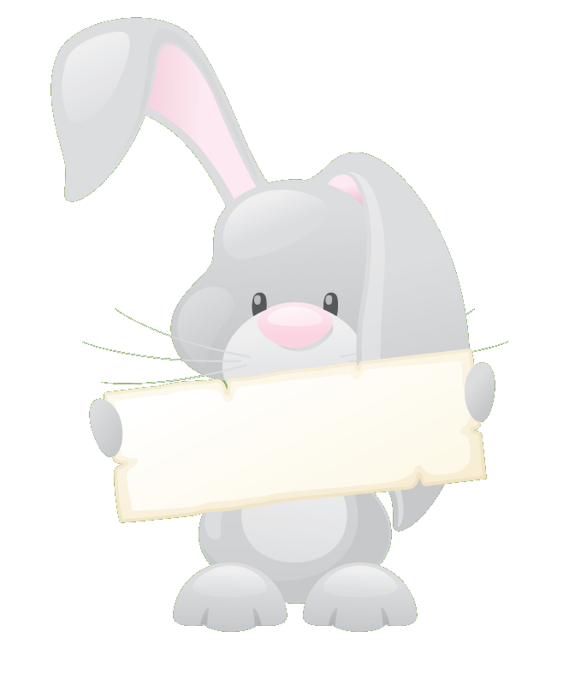
Phase 2
31 words
the
to
I
no
go
into
a
an
as
at
if
in
is
it
of
off
on
can
dad
had
back
and
get
big
him
his
not
got
up
mum
but

Slide 5
Phase 3
24 words
down
look
for
now
too
my
her
we
be
you
they
all
are
me
was
he
she
that
this
then
with
see
will

Slide 6
Phase 4
20 words
little
so
said
do
come
one
have
some
were
when
like
out
what
from
went
it’s
just
help
there
children

Slide 7
Phase 5
25 words
Mr
Mrs
oh
their
old
I’m
day
came
saw
very
put
don’t
by
time
your
here
made
make
house
could
called
asked
about
people
looked

