Slide 1
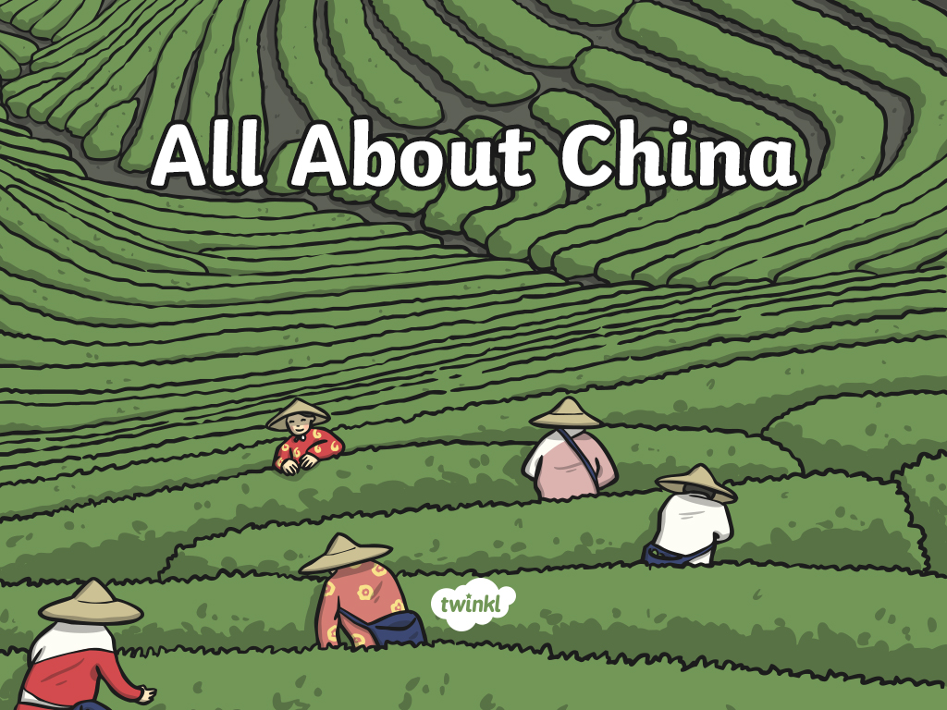

Slide 2
KWL Grid
What I already know | What I would like to know | What I now know

Slide 3
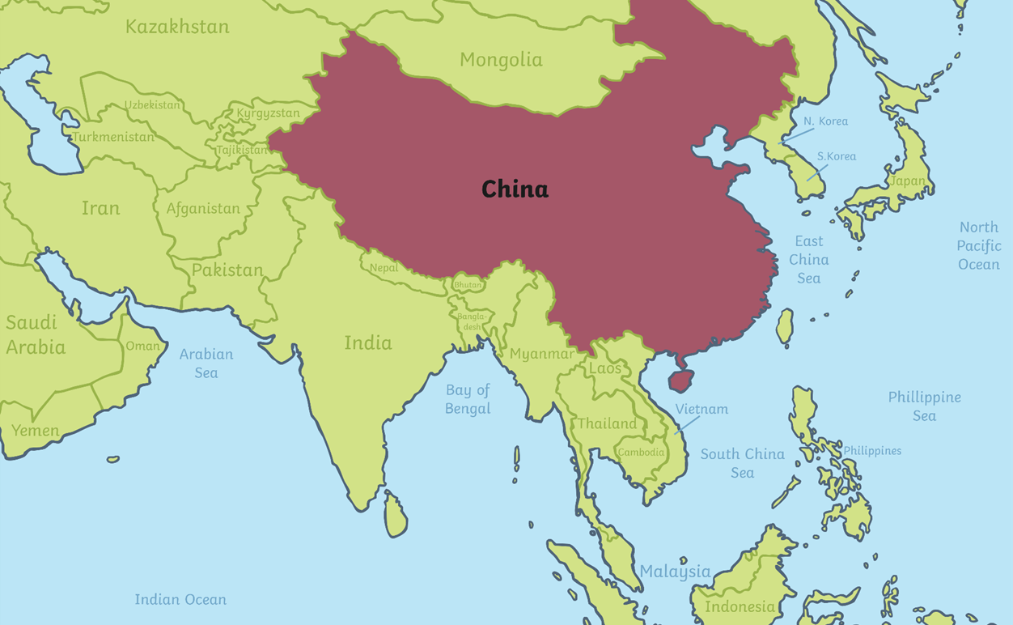
China’s Location
China is a country in Asia.
It is officially known as the People’s Republic of China (PRC).
It is the world’s second largest country.

Slide 4
China’s Location
The capital city of China is Beijing.
The largest city in China is Shanghai.
Beijing
Shanghai
China is the most populous country in the world with over 1.35 billion people living there.
It contains the third and sixth longest rivers in the world, the Yangtze and the Yellow rivers.

Slide 5
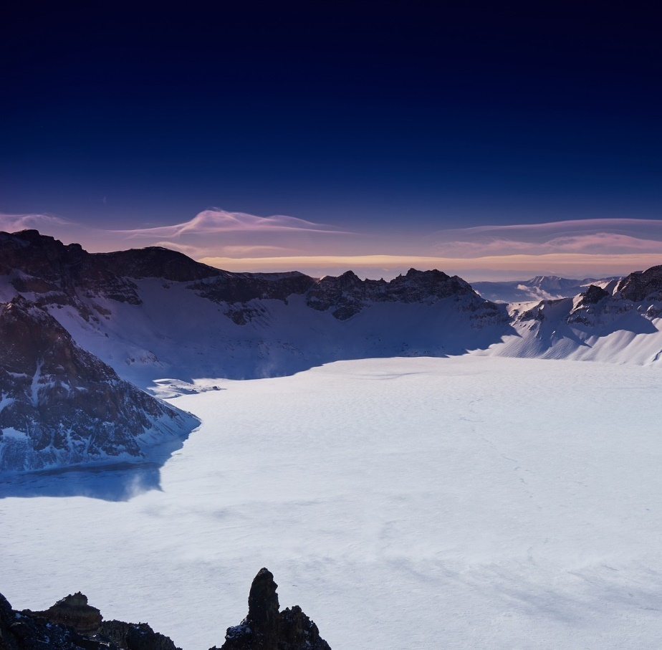
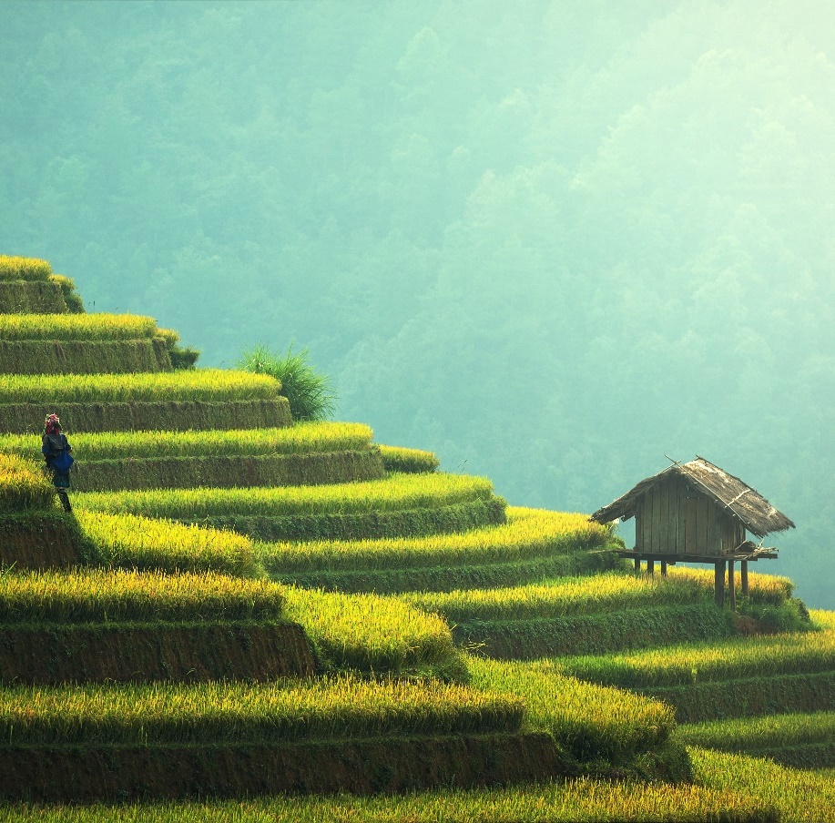
China’s Climate
China’s range of landscapes and environments are extremely vast, making the temperatures vary greatly across the country.

Slide 6
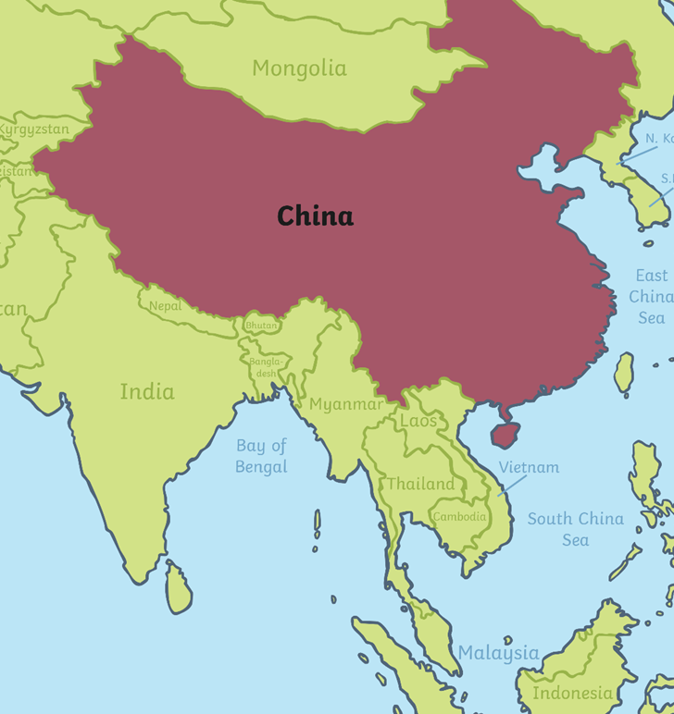

China’s Climate
Dry seasons and wet monsoons are quite typical.
“The Three Furnaces” is a name referring to the hottest and most humid cities of China: Chongqing, Wuhan, and Nanjing.
China’s climate is extremely varied.
Nanjing
Chongqing
Wuhan

Slide 7
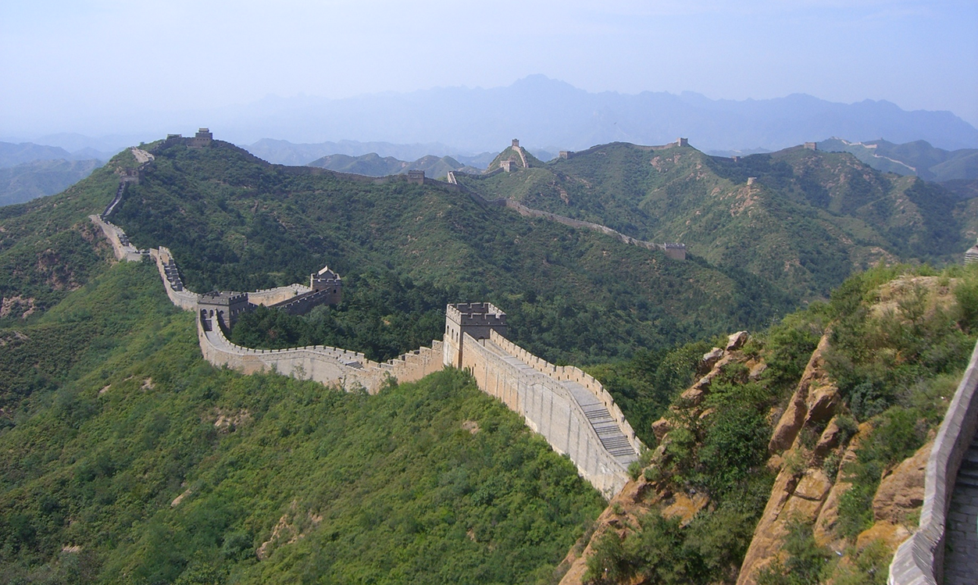
The Great Wall of China

Slide 8
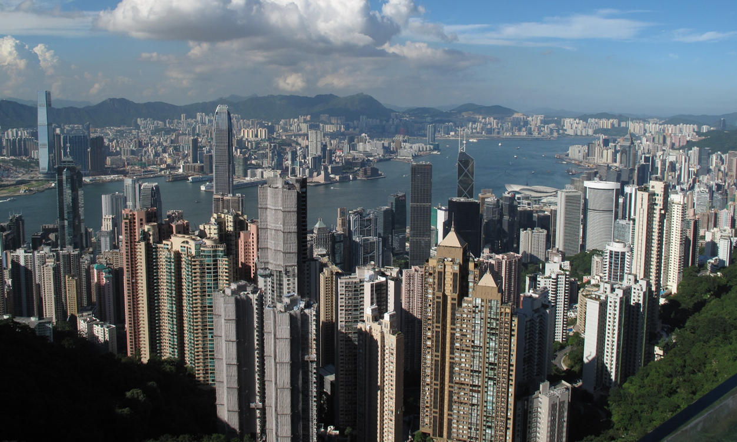
Hong Kong

Slide 9
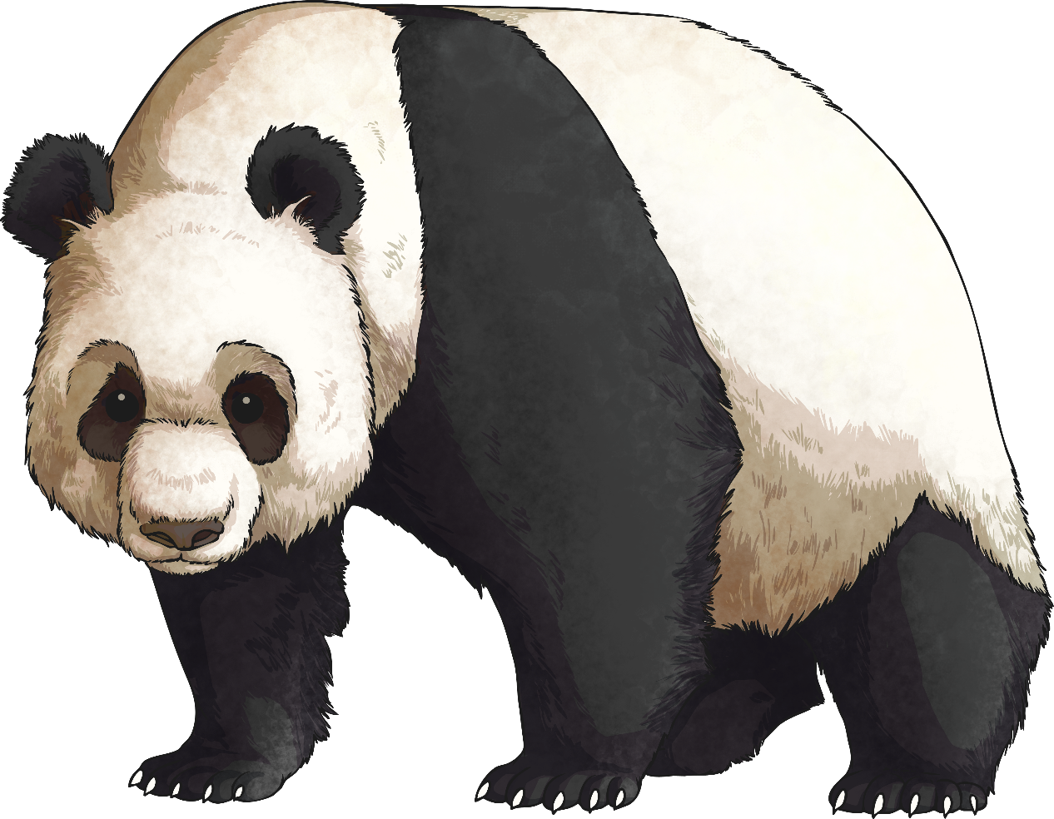
Culture
The official language of China is Mandarin, though there are many different Chinese dialects spoken all over the country.
The Great Wall of China is the largest man-made structure in the world.
The Giant Panda is native to China.

Slide 10
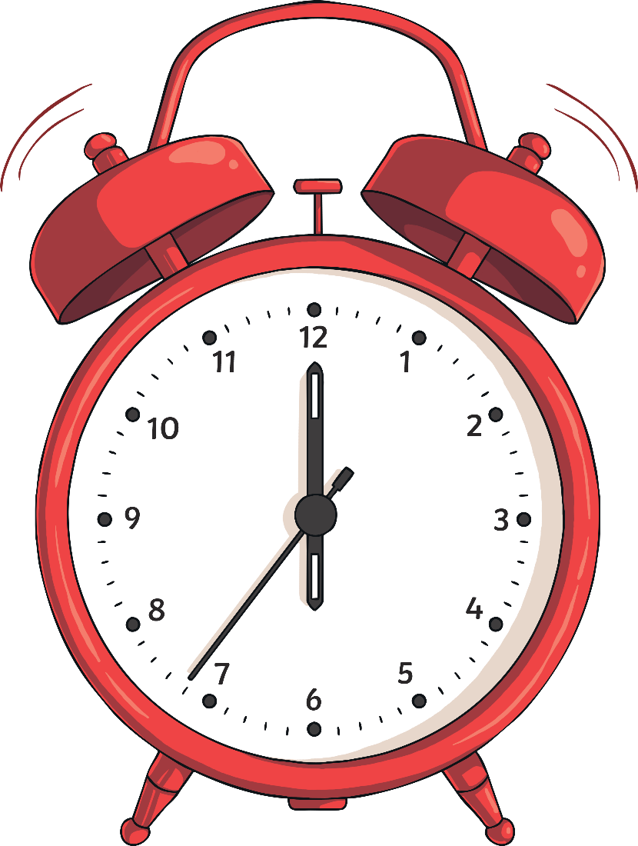
Though China technically runs through five time zones, the whole country actually runs on Beijing time, meaning that sunrise can happen as late as 10 a.m. in Western China.
The currency used is the Chinese Yuan Renminbi, commonly called Yuans (CNY, ¥).

Slide 11
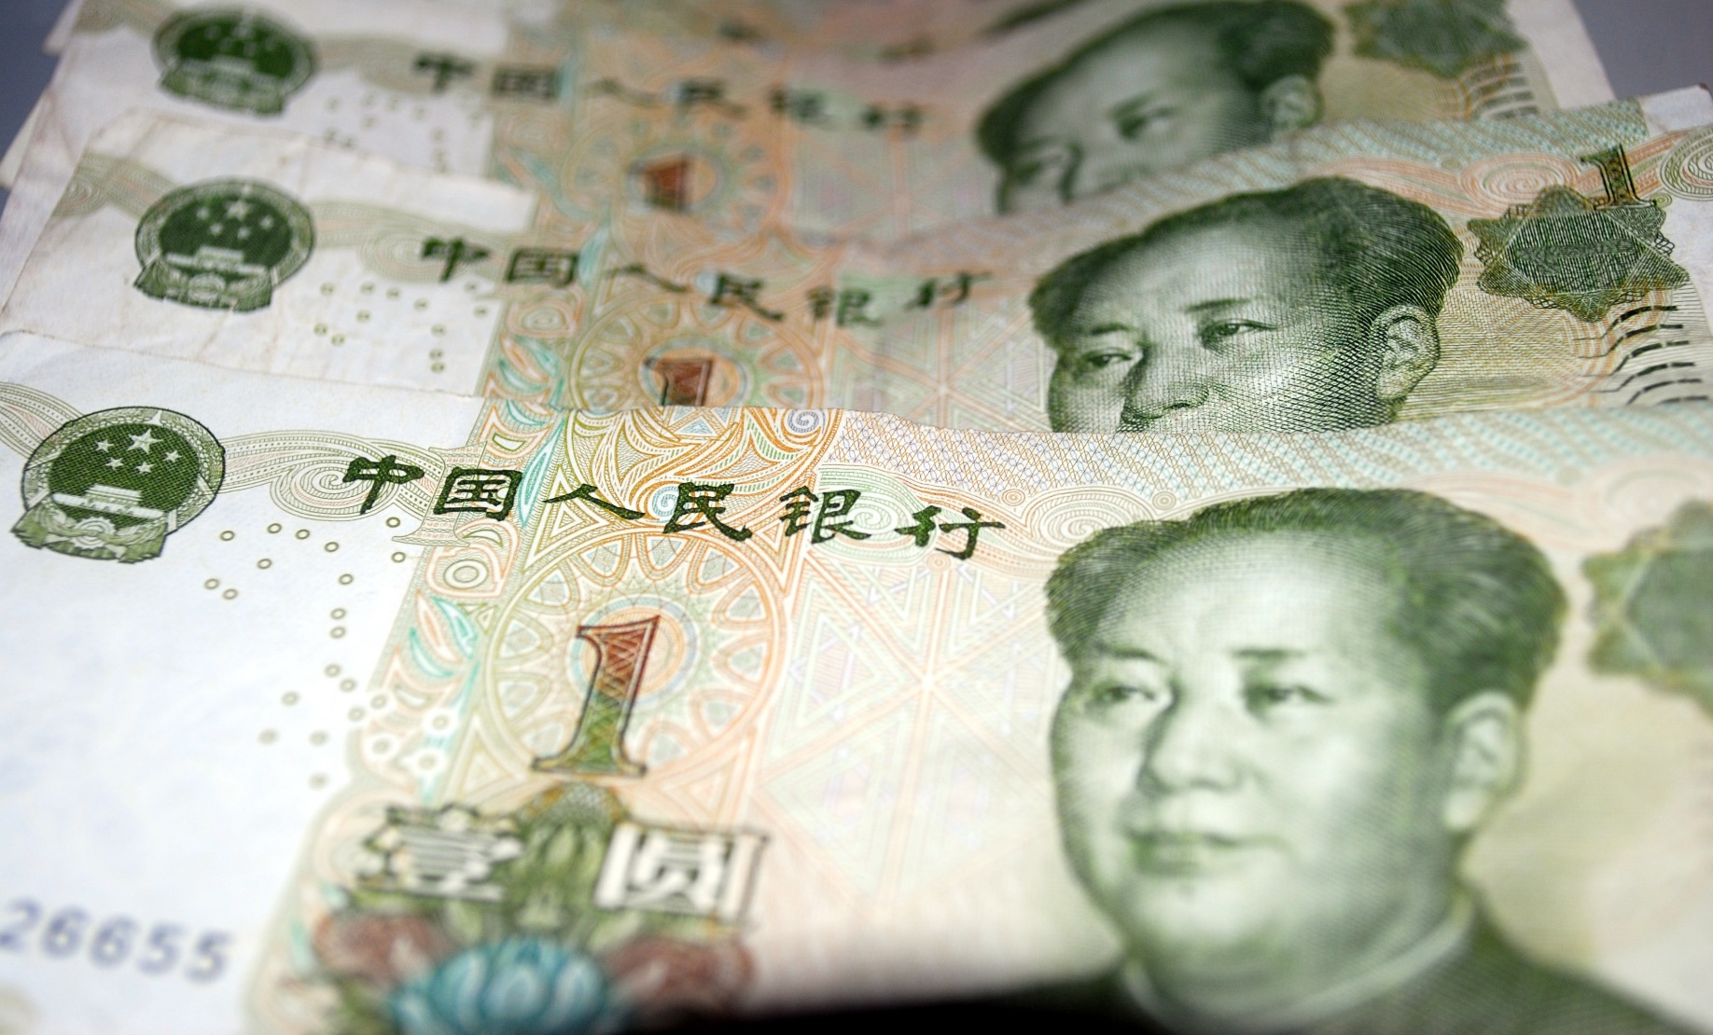
One Yuan Notes

Slide 12
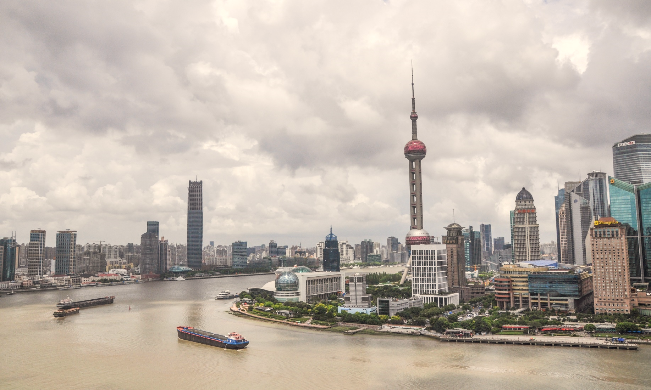
Shanghai

Slide 13
Chinese | Pronunciation | English
你好 | Nǐ hǎo | Hello
你好吗 | Nǐ hǎo ma | How are you?
很高兴认识你 | Hěn gāoxìng rènshí nǐ | Pleased to meet you
对不起/打扰一下 | Duìbùqǐ/dǎrǎo yīxià | Excuse me
再见 | Zàijiàn | Goodbye

