Slide 1


Slide 2
Aim
I can describe the Colosseum as a site of Ancient Roman entertainment and where the different social classes of the Ancient Roman society sat.
Success Criteria
I can explain why Ancient Romans attended the Colosseum.
I can explain where the different social classes of the Ancient Roman society sat in the Colosseum.
I can explain the role of the Emperor and the senators in Ancient Roman society.
I can explain who the gladiators were and their role in relation to the Colosseum.

Slide 3
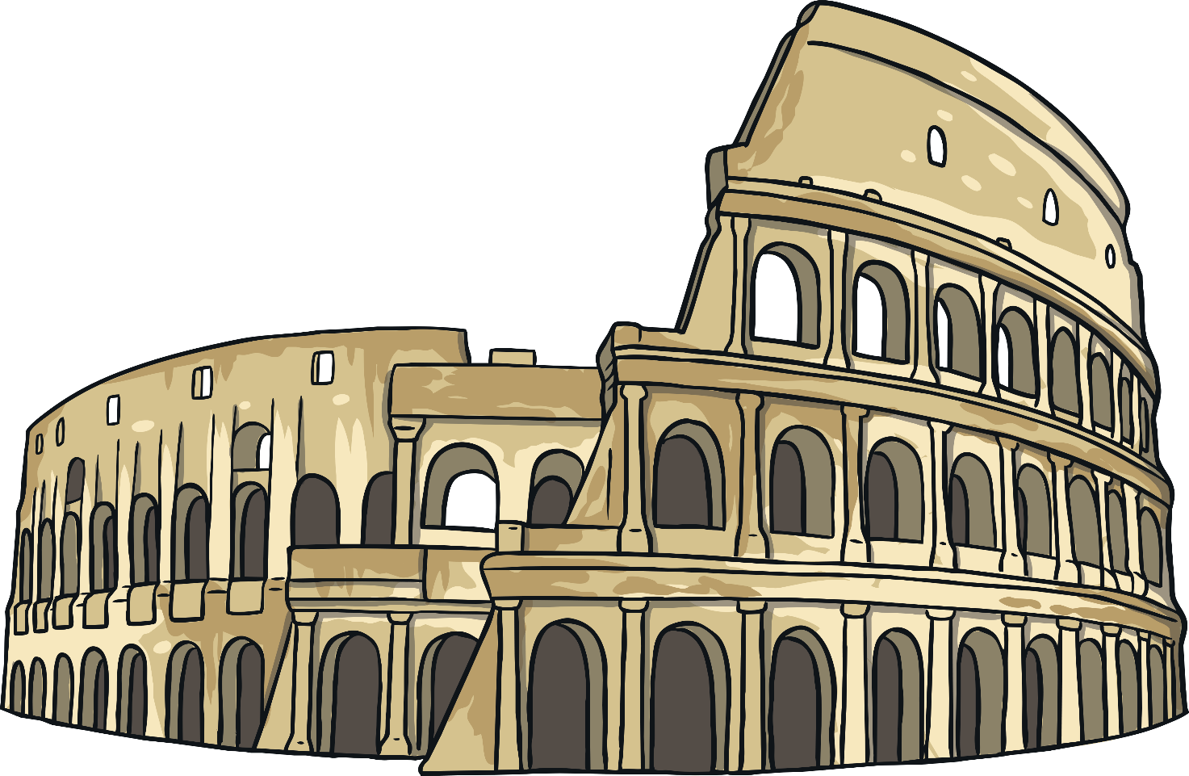
A Roman Amphitheatre
The Colosseum is a Roman amphitheatre. Its name in Latin was Amphitheatrum Flavium Romae. Latin was the language of the Roman Empire and many European languages spoken today, such as Spanish, French, Portuguese or Italian come from Latin.
Attending the Colosseum was part of Ancient Roman life.
Can you imagine why?

Slide 4
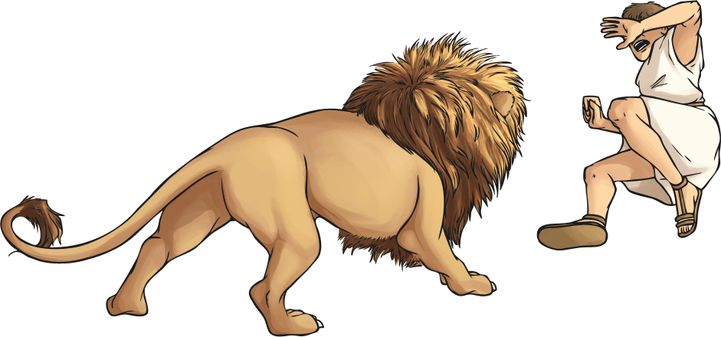
A Place for Entertainment
Ancient Romans liked to have fun, but they had a very different concept
of fun to the way we amuse ourselves nowadays.
For example, they enjoyed watching people fight against lions! They were
also amused by watching gladiators fight to death.
The Colosseum is the largest amphitheatre ever built. It had seating for
55,000 people! That’s as big as the Anfield Football Stadium in Liverpool.
The best place, the Podium, or Tribune, was reserved for the Emperor and his family, as well as for the senators.

Slide 5
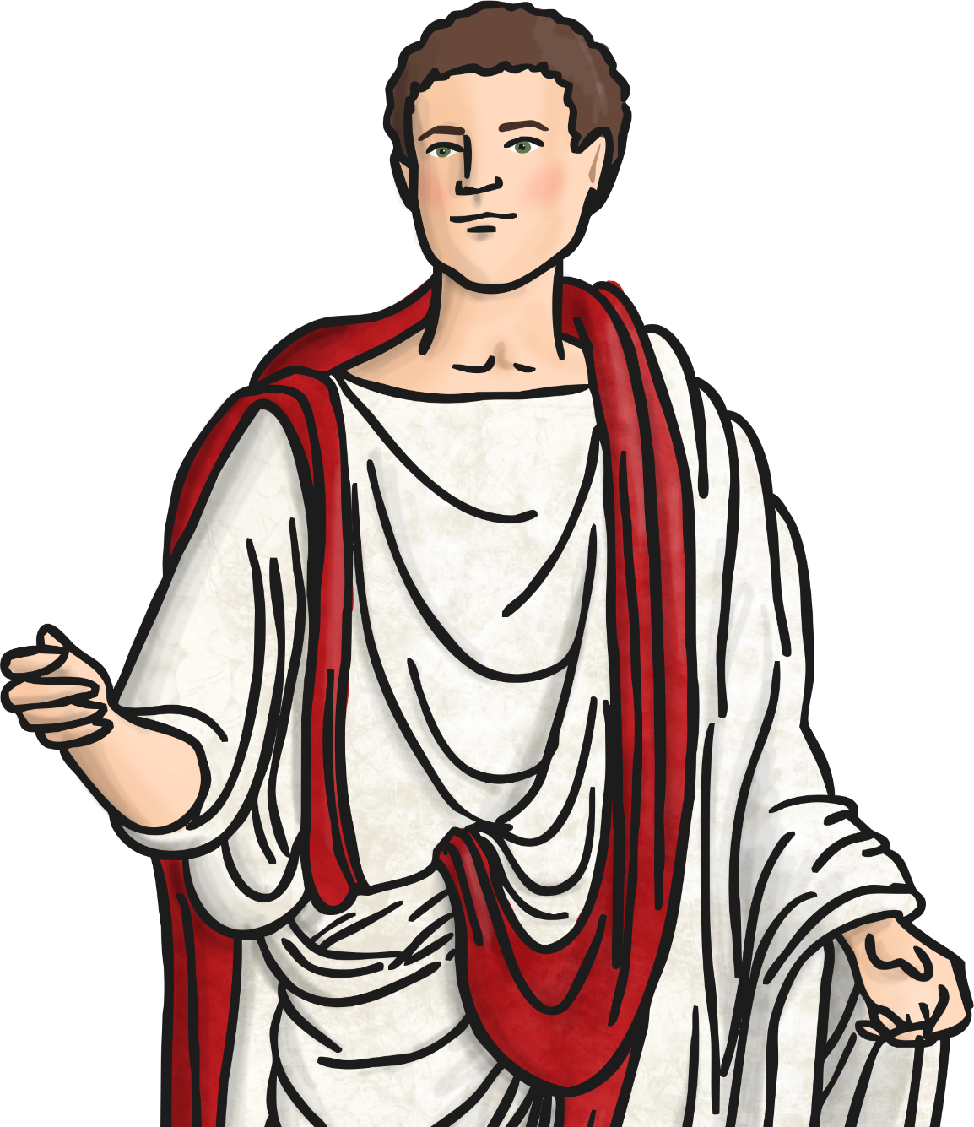
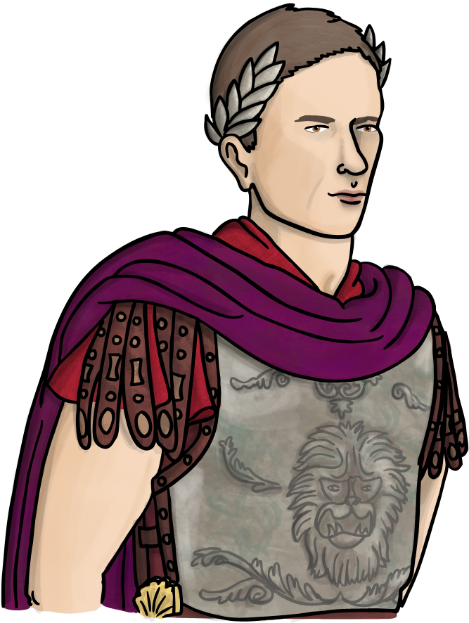
The Emperor and the Senate
The Emperor controlled the Roman Empire and had a very luxurious life with the best of everything.
He was advised by the Senate, which was a group of men, the senators, made up of the wealthy, upper class from powerful families.
Being a senator was a very prestigious and highly respected position. That’s why they sat in the Podium along with the Emperor and his family. They also held the position for the rest of their lives.

Slide 6
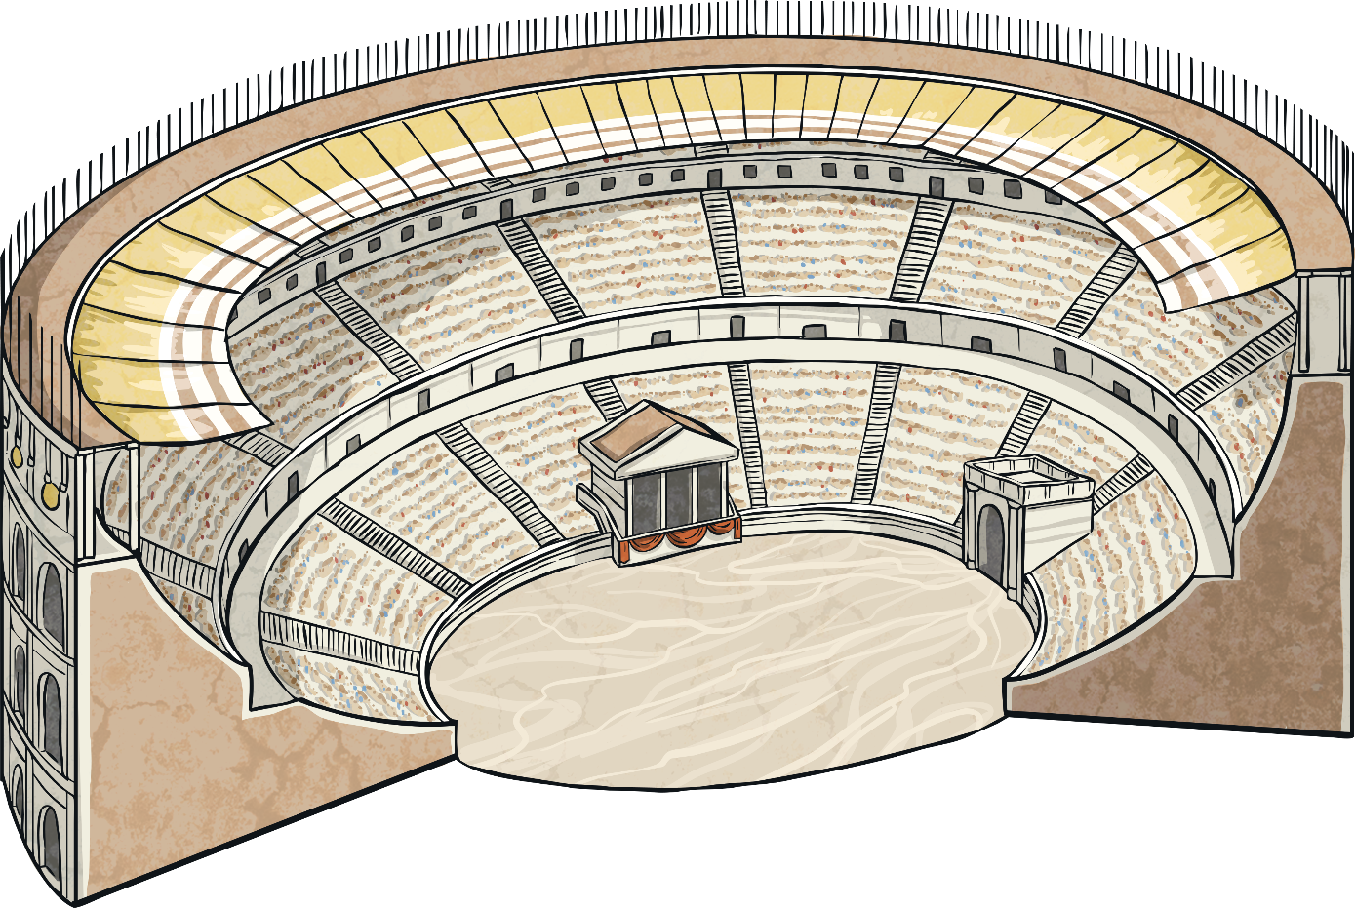

Building the Colosseum
It was Emperor Vespasian who sponsored the building of the Colosseum in AD72, although it was not completed until AD80, in what was already Emperor Titus’ reign.
SUMA CAVEA
MEDIA CAVEA
IMMA CAVEA
PODIUM
The highest sector was a covered tier reserved for plebeian women and slaves.
The third tier was divided into two parts: the lower one for wealthy Roman citizens (plebeians) and the higher one for poor plebeians.
The second tier was reserved for patricians or members of the upper classes who didn’t belong to the Senate.
The first tier provided the best views and was thus reserved for the most important Romans: the Emperor, his family and the Senate.
The Colosseum was designed so that the different social classes could sit in different sectors.
Click on the labels to discover where everyone sat.
SUMA CAVEA
MEDIA CAVEA
IMMA CAVEA
PODIUM

Slide 7
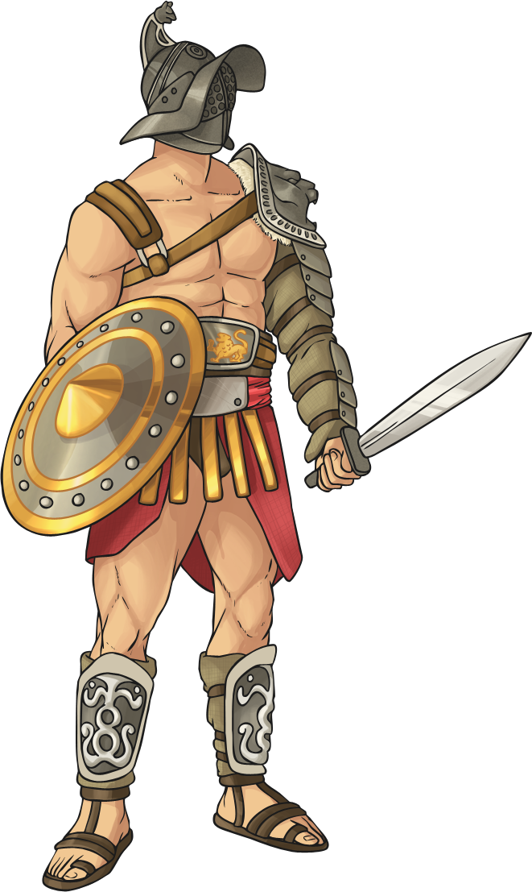

Gladiators
Gladiators were slaves or prisoners who were forced to fight until death against each other or against beasts. Sometimes, if audiences requested it and the highest authority agreed, their lives were spared as a reward for fighting heroically.
Can you think what signal was used by the Emperor to spare or condemn the gladiator?
That’s right! If the Emperor gave a thumbs up, the gladiator would live. If it was a thumbs down, the gladiator would die.

Slide 8
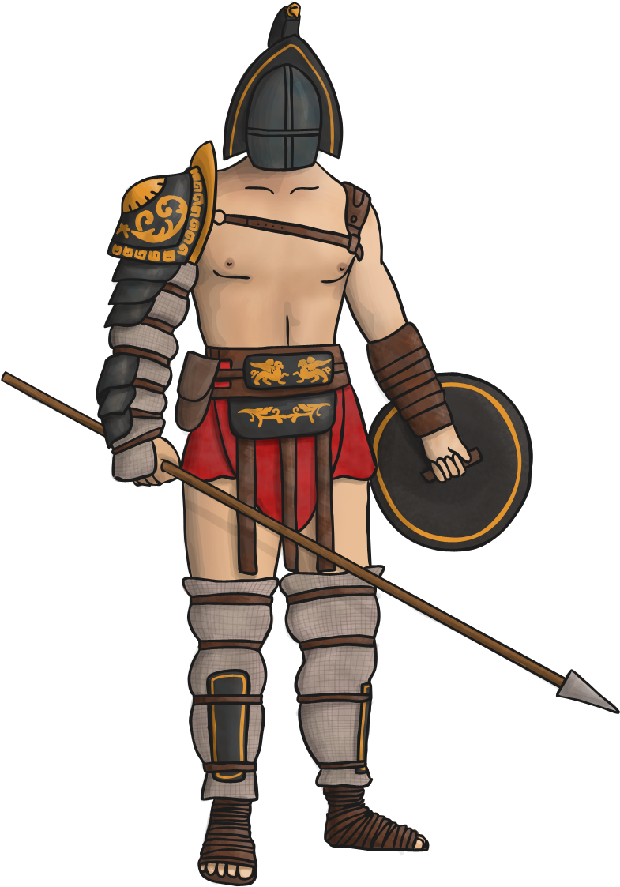
A Gladiator’s Weapons
Gladiators had special weapons and protection gear to use in the Colosseum’s arena. Do you know any of their names?
arm protection
helmet
leather strapping
shorts
shield
leg protection
spear
leather sandal
padded cloth

Slide 9
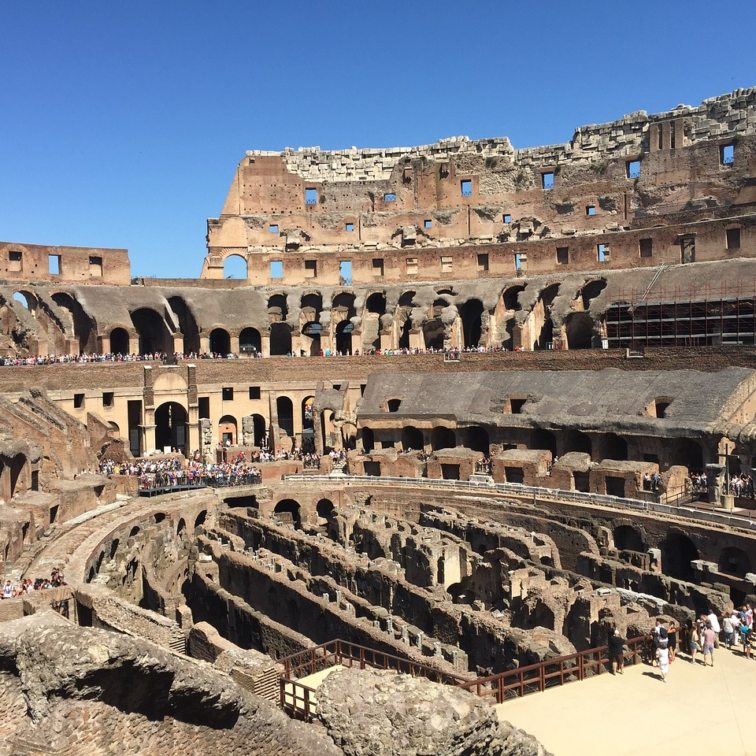
Turning Sand into Water
Can you imagine the Colosseum as the site of an epic mock sea battle?
If you’ve ever visited Rome, the ruins inside the Colosseum clearly show the labyrinth of corridors that was hidden under the Colosseum’s arena. The technical name for this vast network of tunnels and passages was the hypogeum.
Thanks to the hypogeum, it was possible to pretend there was a mock ship battle or naumachia going on, and tell audiences stories of historical
naval battles.

Slide 10
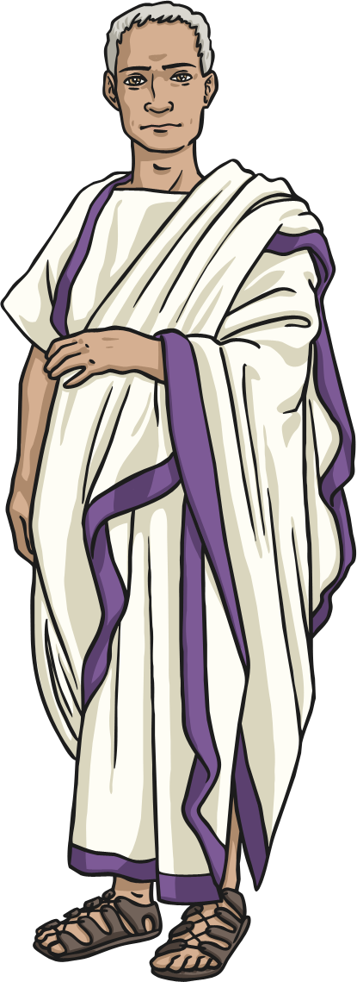
An Evening at the Roman Colosseum
Your task is to narrate what a Roman senator watches from his seat on the podium during an evening at the Roman Colosseum.
Describe a fight between gladiators against beasts and/or a mock sea battle or naumachia.
Remember to include details about how the Emperor decides whether the winning gladiator must live or die.

Slide 11
Aim
I can describe the Colosseum as a site of Ancient Roman entertainment and where the different social classes of the Ancient Roman society sat.
Success Criteria
I can explain why Ancient Romans attended the Colosseum.
I can explain where the different social classes of the Ancient Roman society sat in the Colosseum.
I can explain the role of the Emperor and the senators in Ancient Roman society.
I can explain who the gladiators were and their role in relation to the Colosseum.

