Slide 2
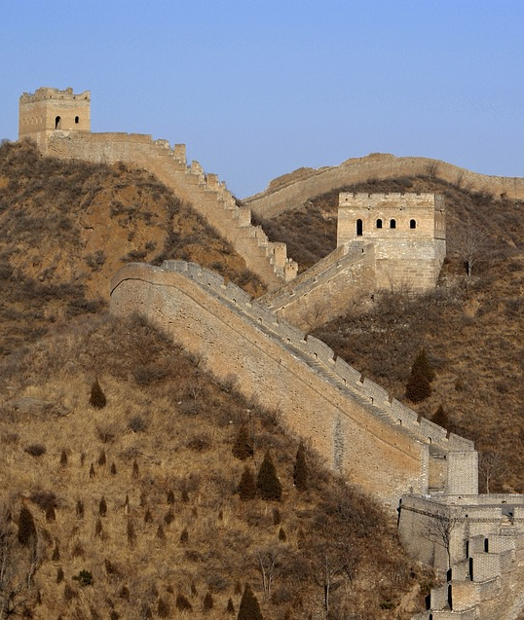
Who Built the Wall?
The building of the wall began
over 2000 years ago, around 200
BC, on the orders of the first
emperor of China, Qin Shi
Huang. He wanted to protect his
new dynasty so he added to a
wall that had been started 500
years before.
Did You Know…?
Hundreds of thousands of slaves and prisoners
took over 1000 years to build it.

Slide 3
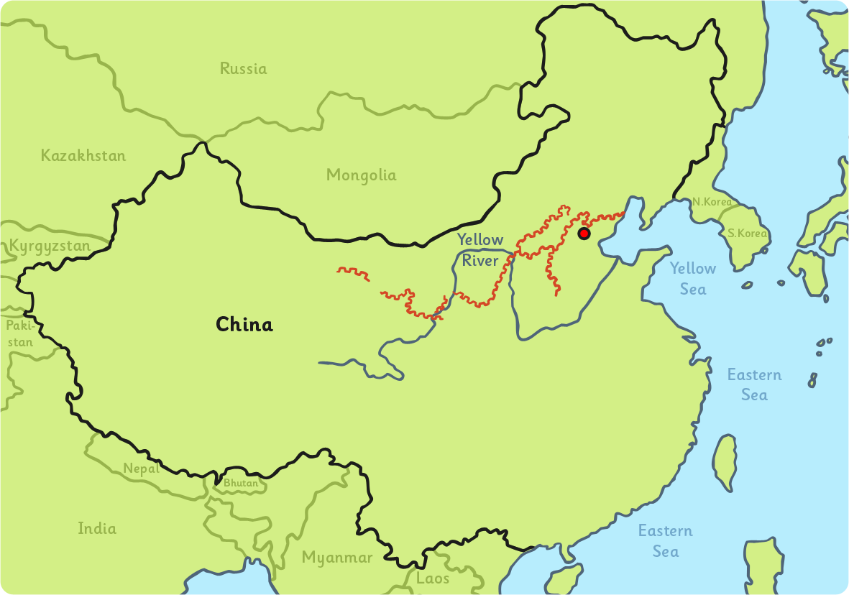
Where Is the Wall?
The Great Wall of China runs across China from east to west.
China is on the continent of Asia. The wall runs near the borders with Mongolia and the Gobi Desert.

Slide 4
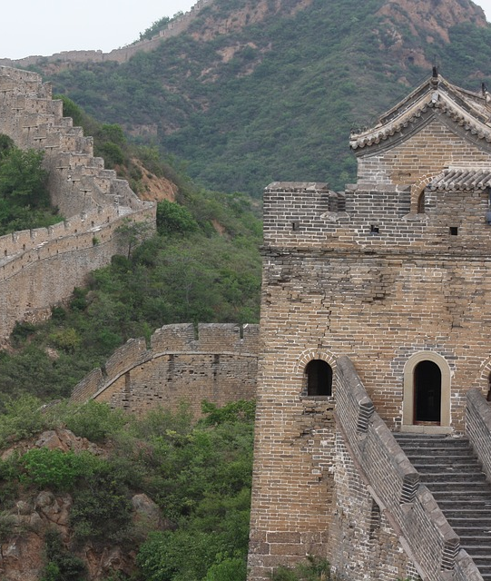
Why Was the Wall Built?
When the wall was started, China
was split into lots of different
groups and there were many
wars. The wall was built as a
defence against any groups that
tried to invade from the north.
Did You Know…?
Along the wall are 7000
fortresses. These were places that
soldiers lived in to guard the wall.

Slide 5
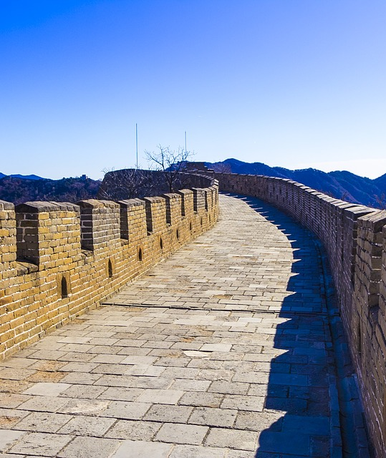
How Big Is the Wall?
The Great Wall of China stretches
for an amazing 21,196km or 13,170
miles. That is nearly half the
distance from one side of the
world to the other!
The wall has an average height of
6 metres but its highest point is
about 14 metres. That is as tall as
two London buses balancing on
top of each other, end to end! In
some areas, the wall is made up
of mountains and rivers, so there
is no wall at all.
The top of the wall is wide
enough to allow people, animals
and carts to travel along it.

Slide 6
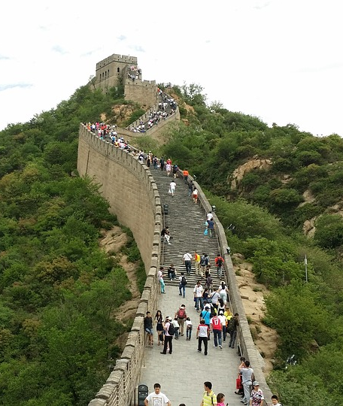
Can You Visit the Wall?
The Great Wall of China has been
popular with visitors for hundreds
of years. Today, over 10 million
people visit it each year, making it
one of the most popular places in
the world.
Some parts of the wall have
cable cars and toboggans to help
with the journey up and down.
Because of the shape of the wall,
some of the cable car rides are
like a rollercoaster!
Did You Know…?

Slide 7
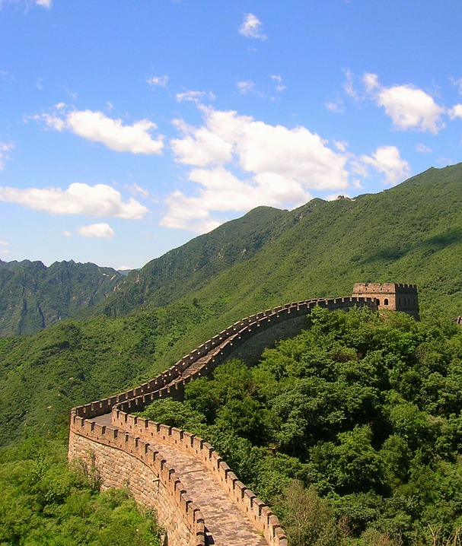
The Dragon and the Wall
Where the Great Wall of China
meets the sea is known as ‘Old
Dragon’s Head’. It is believed that
the shape of the wall was marked
out by a dragon, which explains
why it is not straight.
Because the Chinese believe that
dragons are a symbol of power,
good luck and friendship, it was
thought the wall was lucky and
was protected by the dragon.
Did You Know…?

