Slide 2

_ocks

Slide 3

_pple

Slide 4

_omato

Slide 5

_ig

Slide 6

_gloo

Slide 7

_ose

Slide 8

_ap

Slide 9
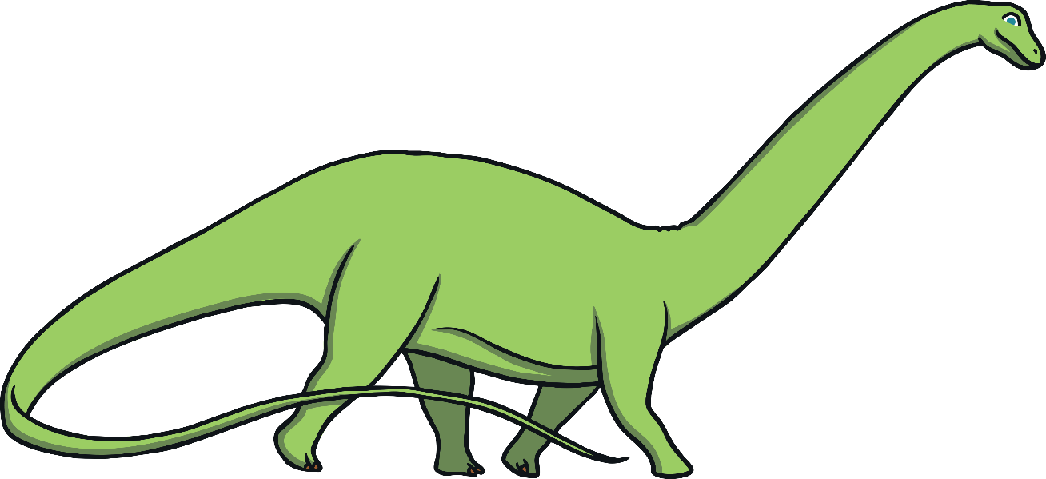
_inosaur

Slide 10

_range

Slide 11

_arrot

Slide 12

_ey

Slide 13

_lephant

Slide 14

_obot

Slide 15

_and

Slide 16

_ird

Slide 17

_lowers

Slide 18

_eaf

