Slide 1


Slide 2



Slide 3
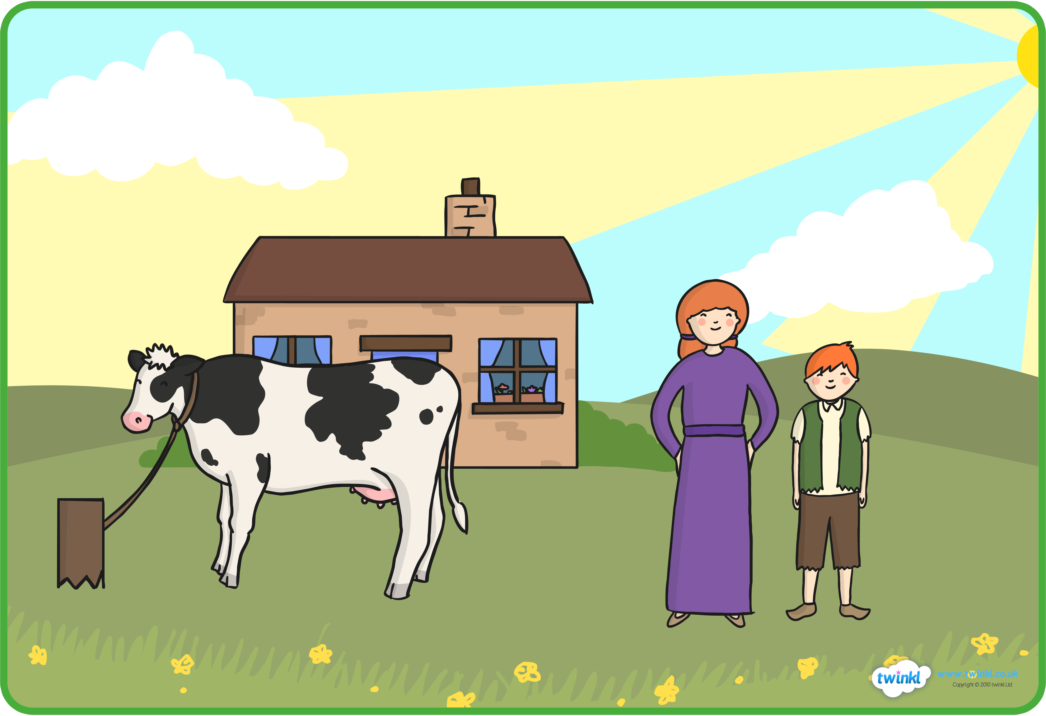


Slide 4

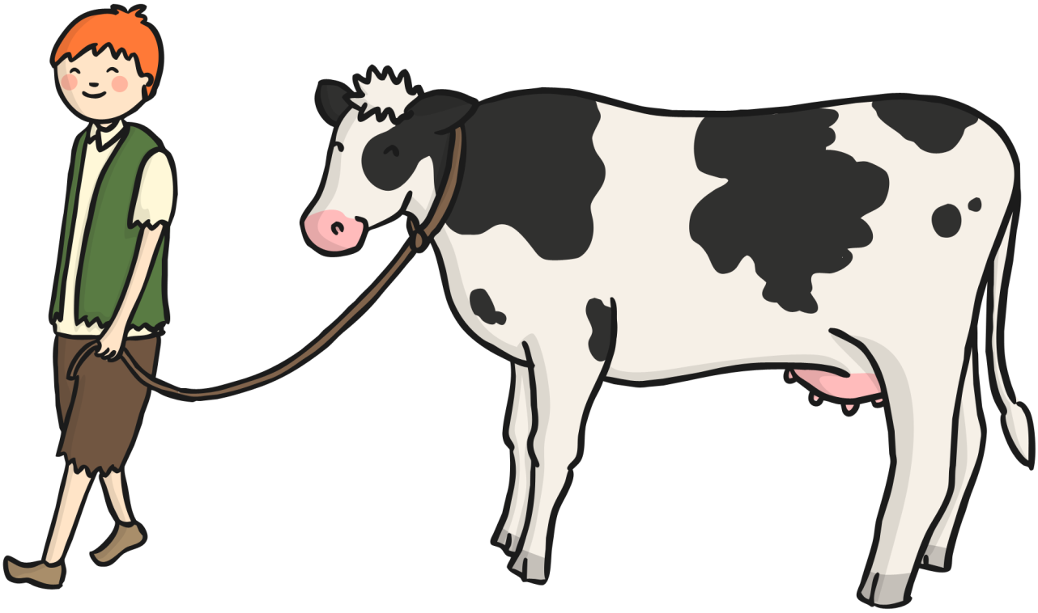

Slide 5
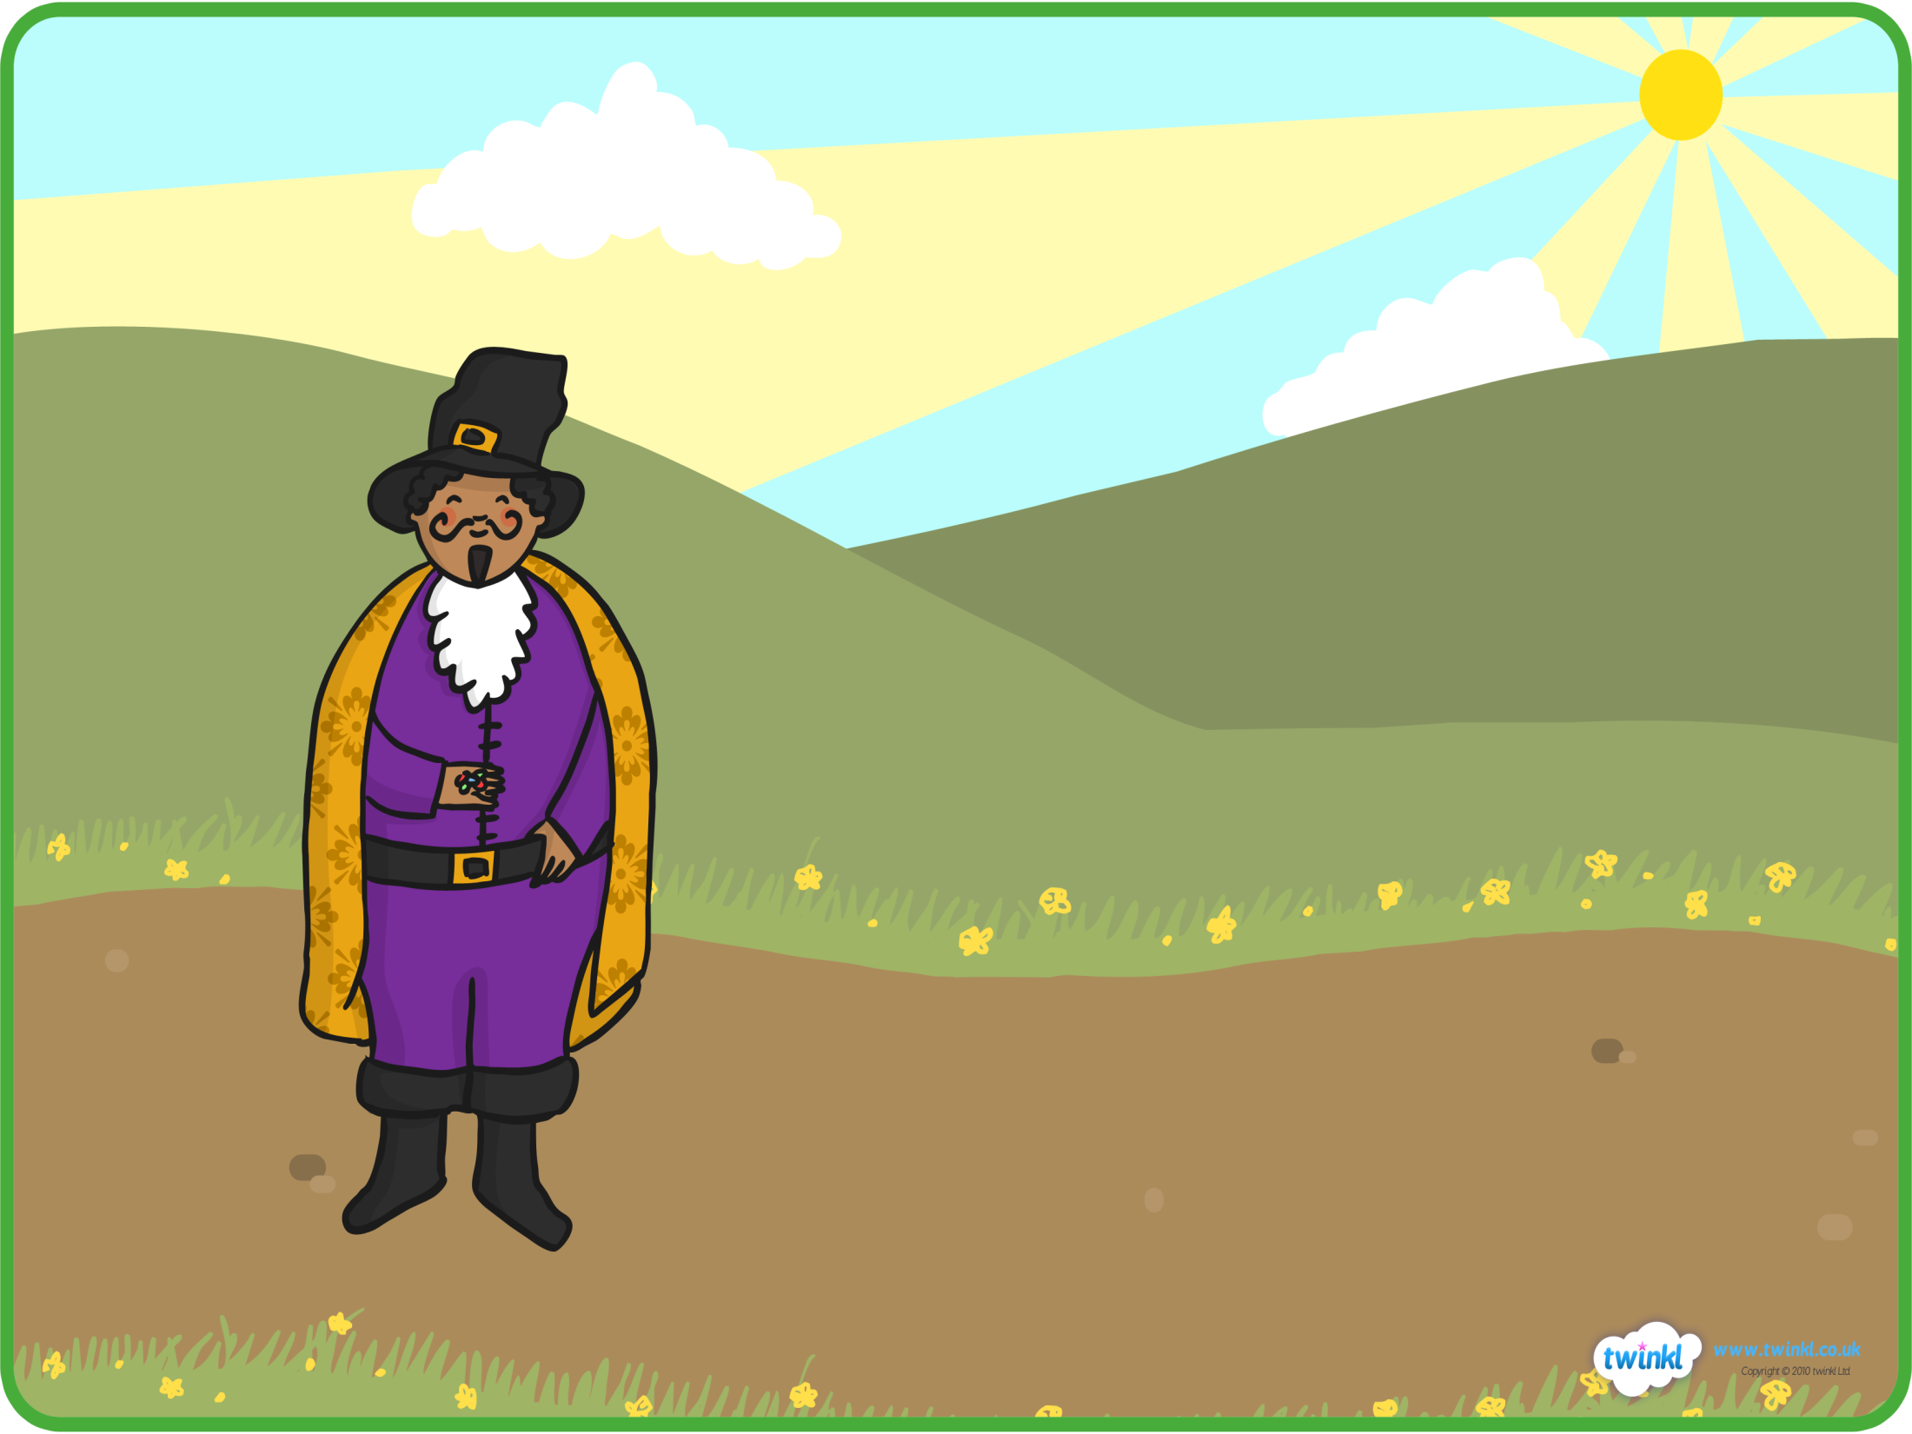


Slide 6
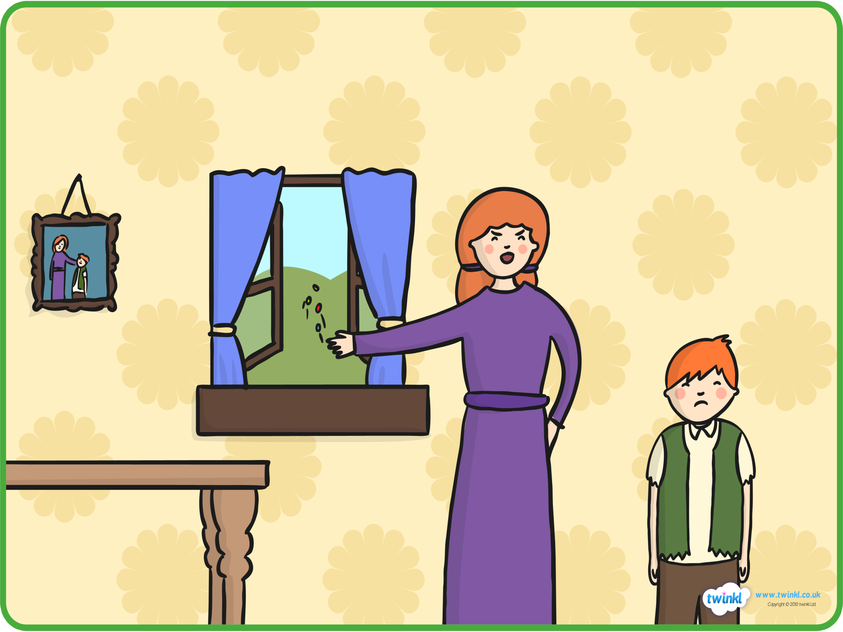


Slide 7



Slide 8




Slide 9



Slide 10


Slide 11



Slide 12

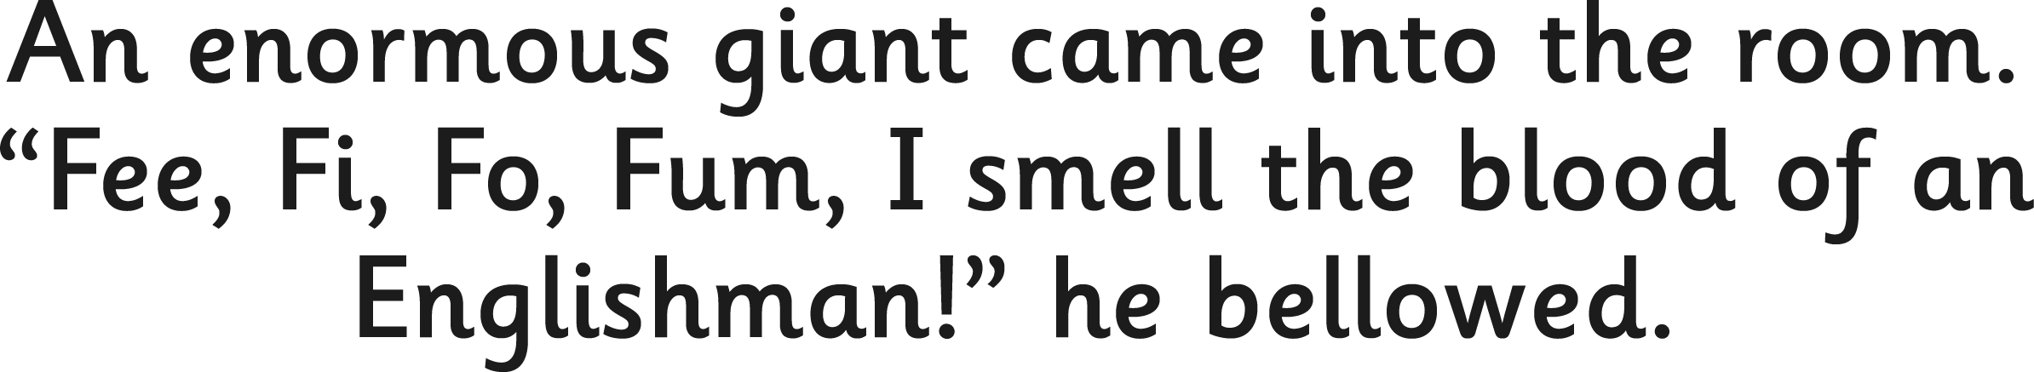
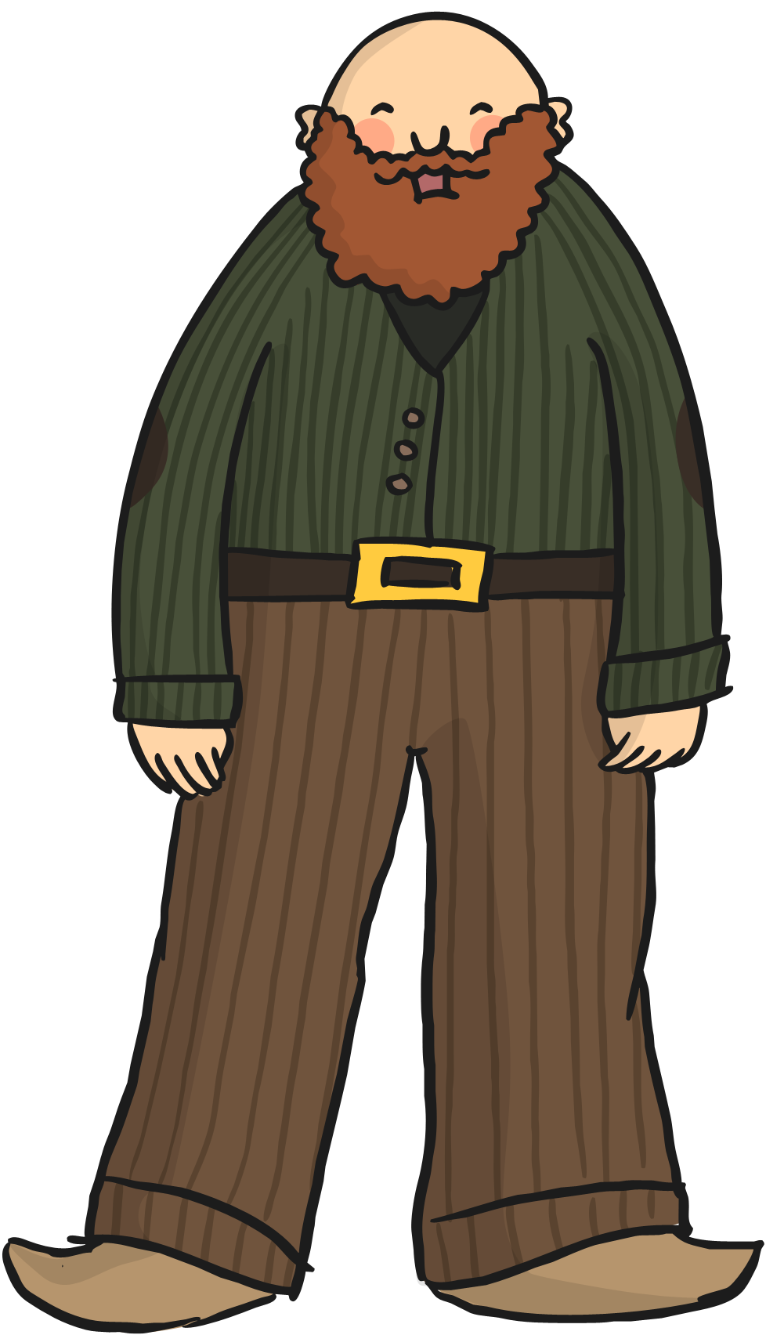

Slide 13
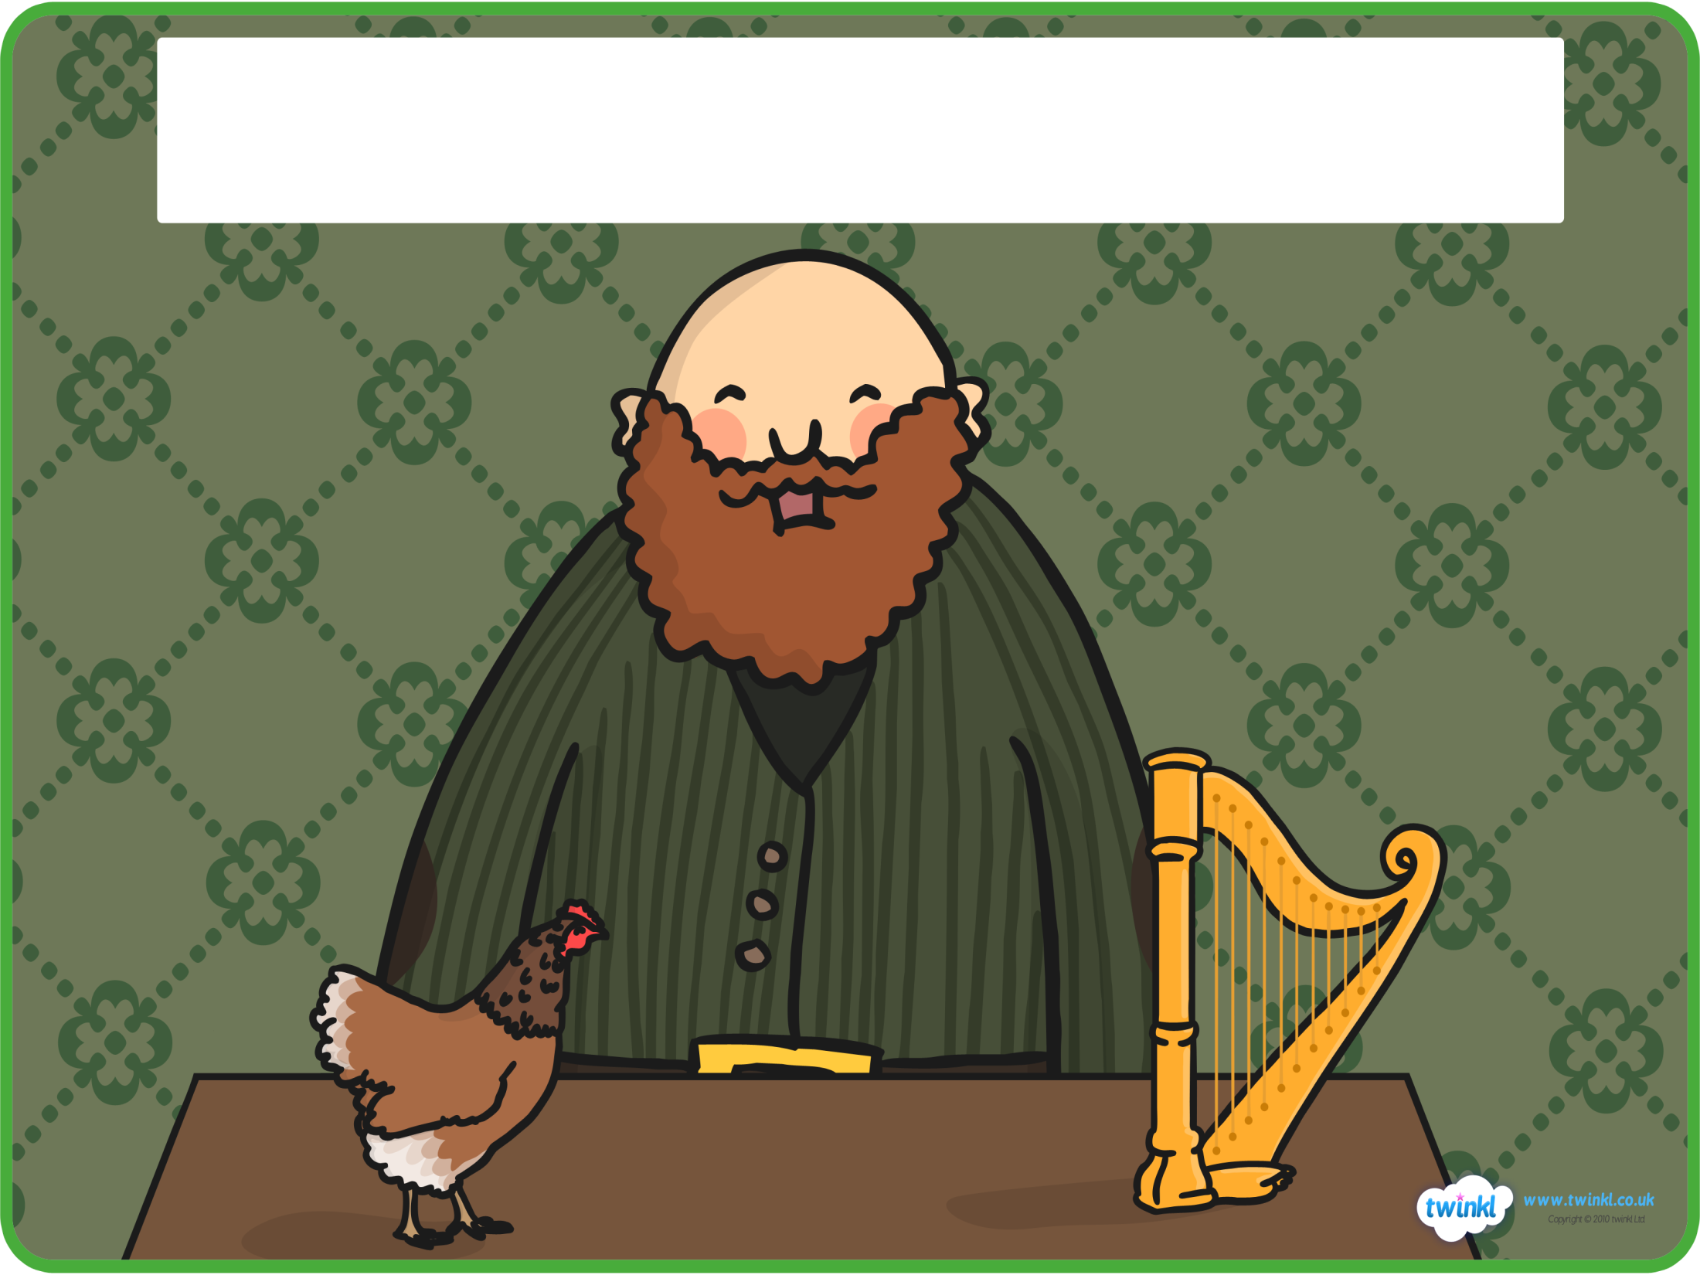


Slide 14

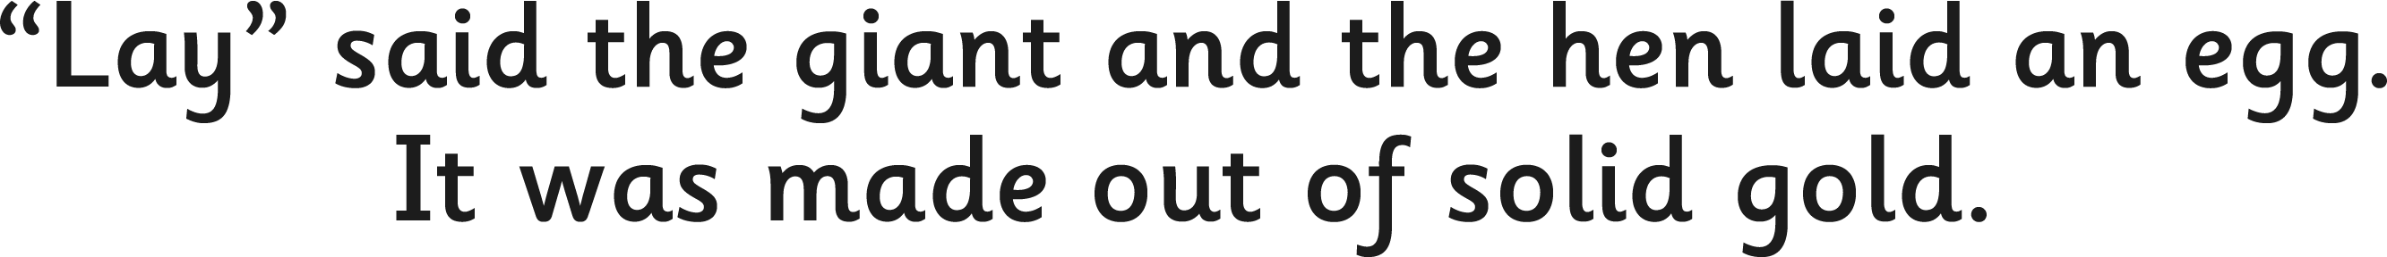


Slide 15




Slide 16


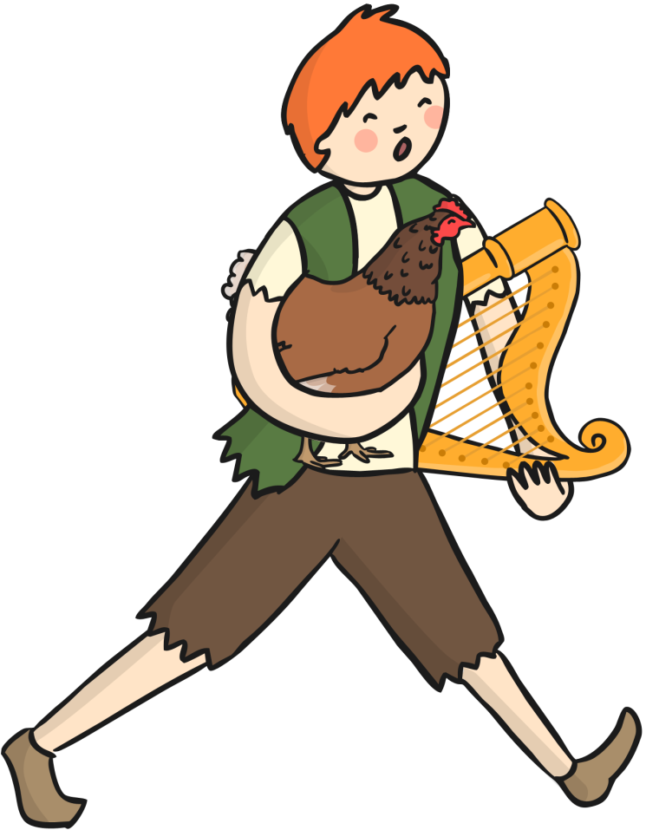

Slide 17


Slide 18


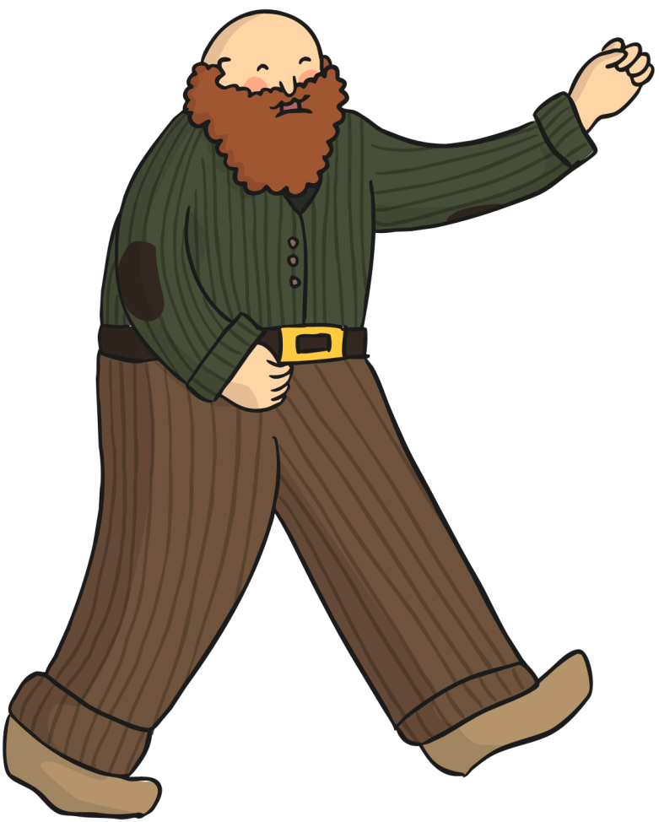
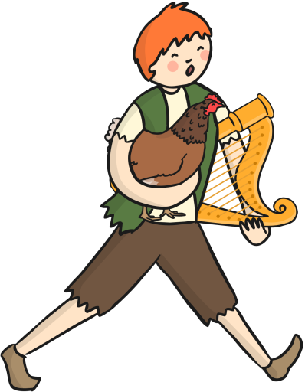

Slide 19



Slide 20
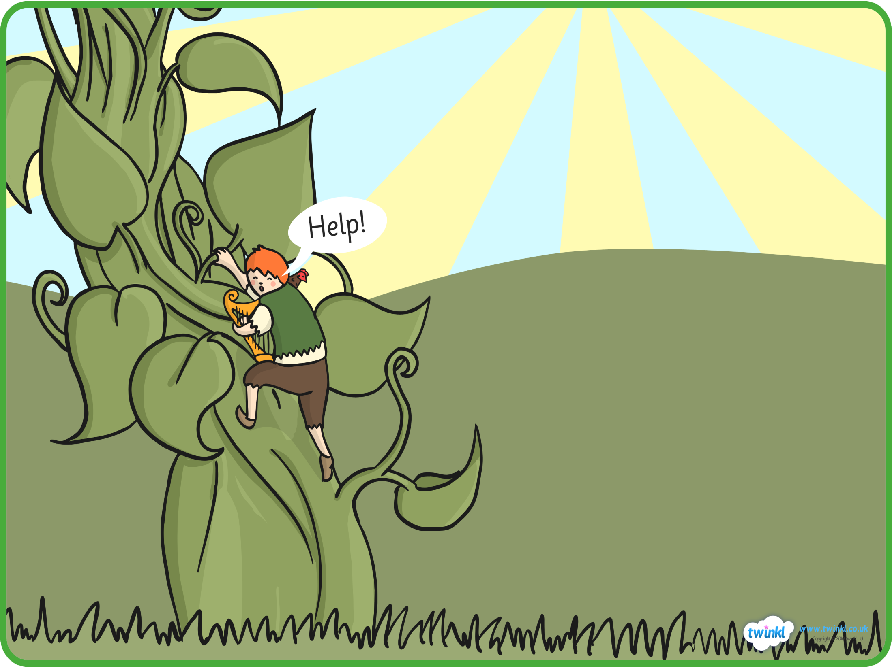


Slide 21




Slide 22




Slide 23




Slide 24

THE END

