Slide 2
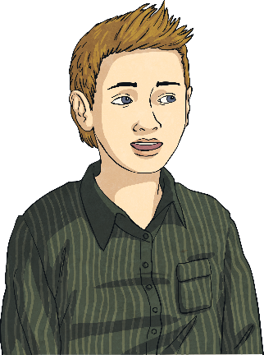
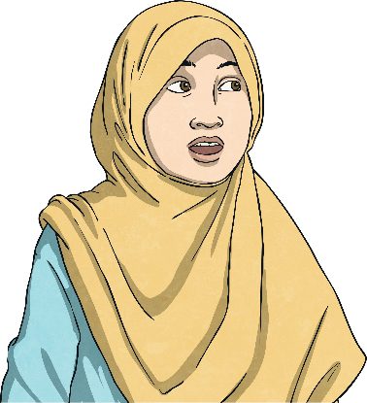
Fraction Wall
Alfie, Fatima and Laura make some fraction walls with small grids.
Using a small piece of squared paper (8 × 3 squares),make a fraction wall to show equivalent fractions of halves, quarters and eighths.
1 2 |  |  |  | 1 2
1 4 |  | 1 4 |  | 1 4 |  | 1 4
1 8 | 1 8 | 1 8 | 1 8 | 1 8 | 1 8 | 1 8 | 1 8
Try to make other fraction walls for:
halves, thirds, sixths
halves, fifths, tenths
Think about the size grid you will need.
1 2 |  |  | 1 2
1 3 |  | 1 3 |  | 1 3
1 6 | 1 6 | 1 6 | 1 6 | 1 6 | 1 6
1 2 |  |  |  |  | 1 2
1 5 |  | 1 5 |  | 1 5 |  | 1 5 |  | 1 5
1 10 | 1 10 | 1 10 | 1 10 | 1 10 | 1 10 | 1 10 | 1 10 | 1 10 | 1 10

Slide 3
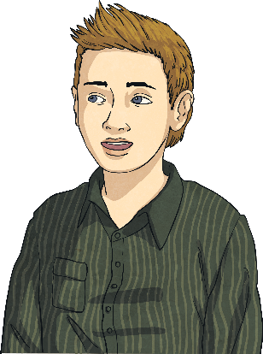
Fraction Circles
Alfie has drawn some shaded circles.
Which circles are equivalent to ½?
A
B
C
D
E
F
G
H
Write the equivalent fraction each circle represents.
2
4
2
4
3
6
4
8
A=
D=
E=
H=
Draw some of your own circles that represent ½ and write the equivalent fraction.

Slide 4
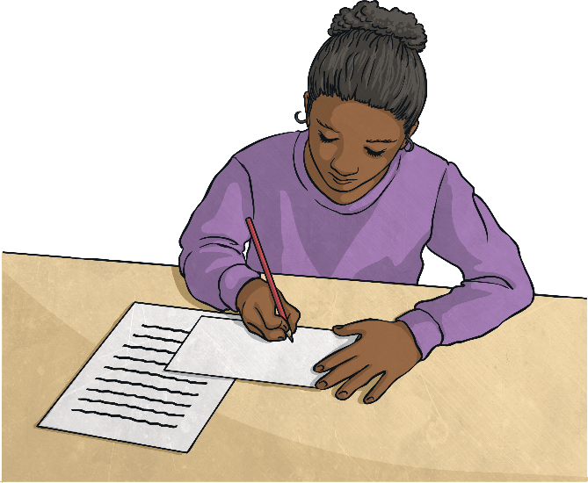
Fraction Squares
A
B
C
D
Laura has drawn some shaded squares.
Which squares are equivalent to ¼?
E
F
G
H
Write the equivalent fraction each square represents.
2
8
2
8
3
12
4
16
B=
D=
F=
G=
Draw some of your own squares that represent ¼ and write the equivalent fraction.

Slide 5
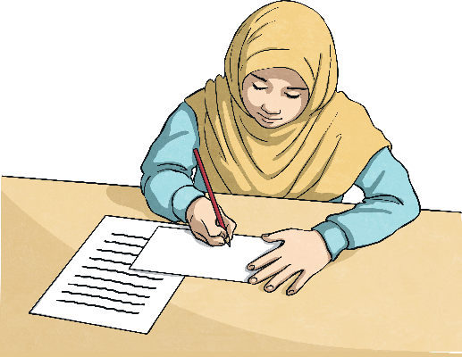
Fraction Rectangles
Fatima has drawn some shaded rectangles.
1
3
Which rectangles are equivalent to ?
A
B
C
D
E
F
G
H
Write the equivalent fraction each rectangle represents.
2
6
2
6
3
9
4
12
B=
D=
F=
H=
Draw some of your own rectangles that represent 1/3 and write the equivalent fraction.

