Slide 2



Diving into Mastery Guidance for Educators
Each activity sheet is split into three sections, diving, deeper and deepest, which are represented by the following icons:
These carefully designed activities take your children through a learning journey, initially ensuring they are fluent with the key concept being taught; then applying this to a range of reasoning and problem-solving activities.
These sheets might not necessarily be used in a linear way. Some children might begin at the ‘Deeper’ section and in fact, others may ‘dive straight in’ to the ‘Deepest’ section if they have already mastered the skill and are applying this to show their depth of understanding.
Diving
Deeper
Deepest

Slide 3
Aim
Multiply numbers up to 4 digits by a one- or two-digit number
using a formal written method, including long multiplication for
two-digit numbers.

Slide 4

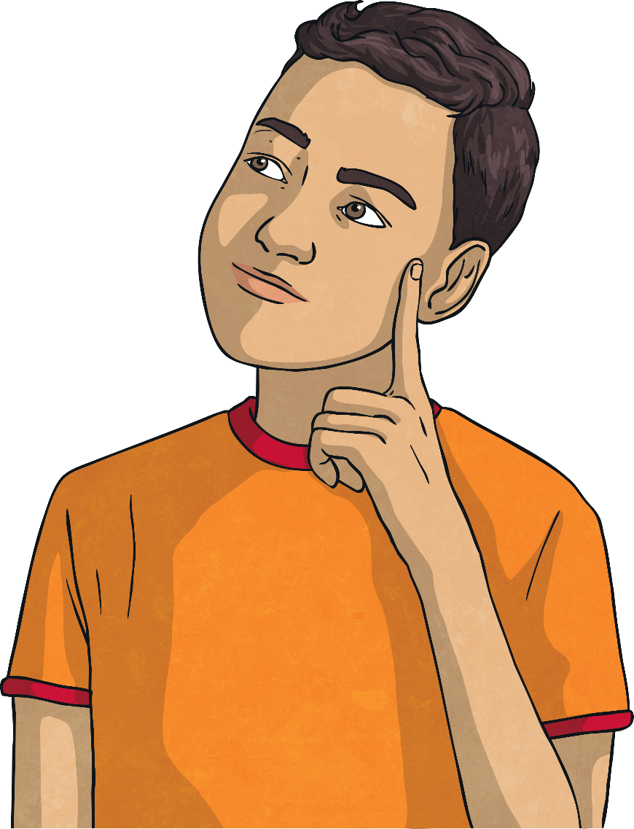
Multiply 2 Digits by 2 Digits
Diving
Complete this calculation.
 |  | 3 | 2
 | × | 4 | 3
9
6
(32 × 3)
1
2
8
0
(32 × 40)
1
3
7
6
1

Slide 5

Multiply 2 Digits by 2 Digits
Diving
Set this calculation out and find the answer.
52 x 47 =
 | ×
5
2
4
7
3
6
4
(52 × 7)
1
2
0
8
0
(52 × 40)
2
4
4
4
1

Slide 6

Multiply 2 Digits by 2 Digits
Deeper
Mohammed has been practising long multiplication. For each question, can you spot his mistake and explain where he has gone wrong?
 | 3 | 5
× | 2 | 6
2 | 1 | 0
 | 7 | 0
2 | 8 | 0
 |  | 4 | 5
 | × | 7 | 3
 | 1 | 3 | 5
3 | 1 | 5 | 0
3 | 5 | 9 | 5
3
1
1
3
Mohammed did not use 0 as a placeholder in the tens column when he calculated 20 x 5.
Mohammed should not have added in the regrouped digits during the final step of the calculation.

Slide 7

Multiply 2 Digits by 2 Digits
Deepest
Identify the missing digits in these calculations.
 |  | 2
 | × | 4 | 3
 |  | 7 | 2
 | 9
1
 |  |  | 6
 | × | 2
 | 3 | 9 | 2
 | 1 |  | 0
1 |  |  | 2
4
5
7
1
4
6
0
1
2
1
0
3
2
5
1
1
1
1

Slide 8


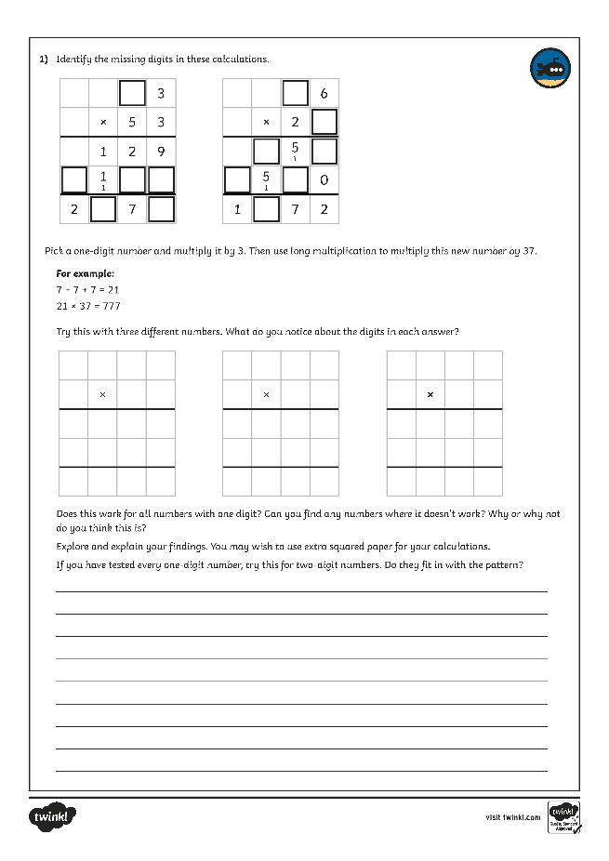
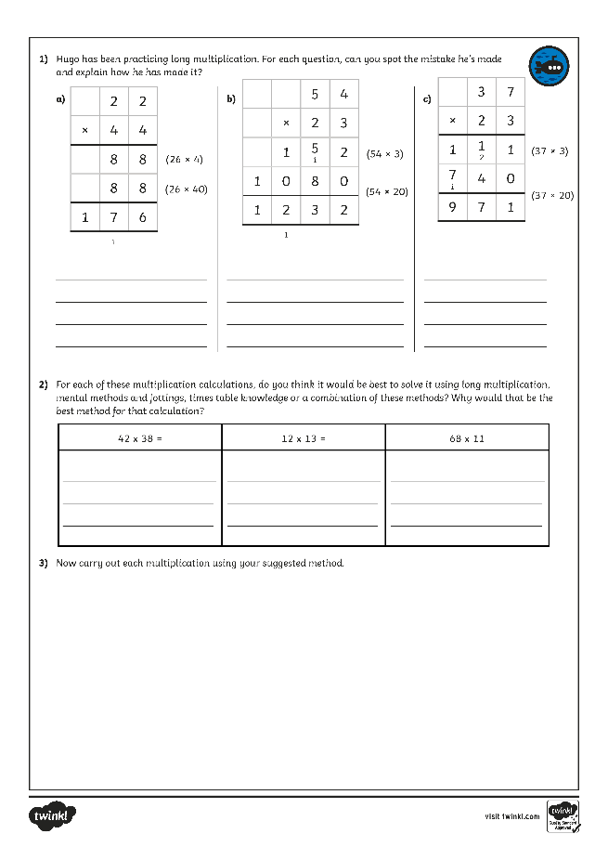
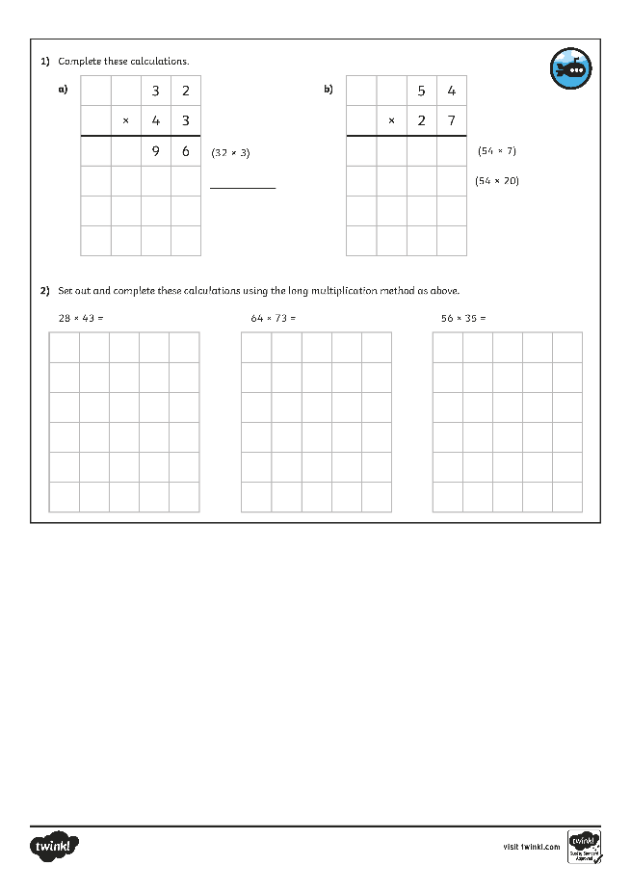
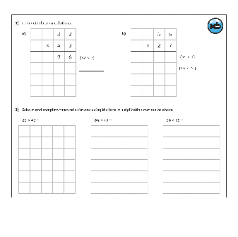
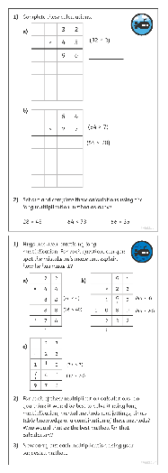
Multiply 2 Digits by 2 Digits
Dive in by completing your own activity!

Slide 9
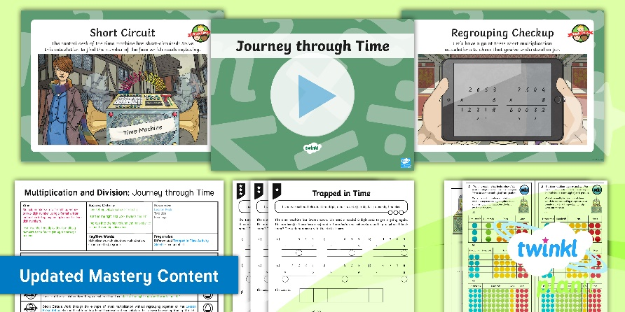
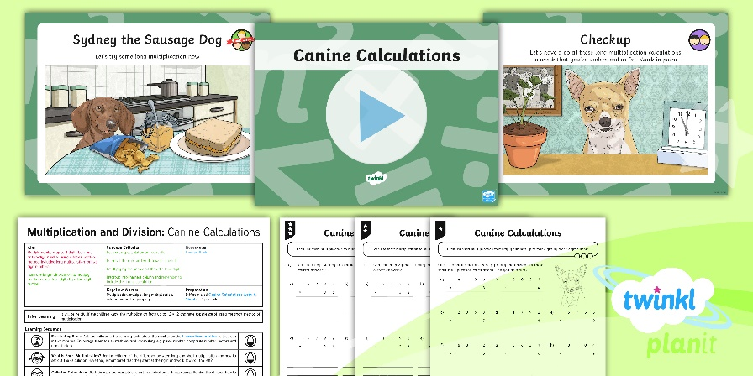

Need Planning to Complement this Resource?
National Curriculum Aim
Multiply numbers up to 4 digits by a one- or two-digit number
using a formal written method, including long multiplication for
two-digit numbers.
For more planning resources to support this aim, click here.
Twinkl PlanIt is our award-winning scheme of work
with over 4000 resources.

