Slide 2
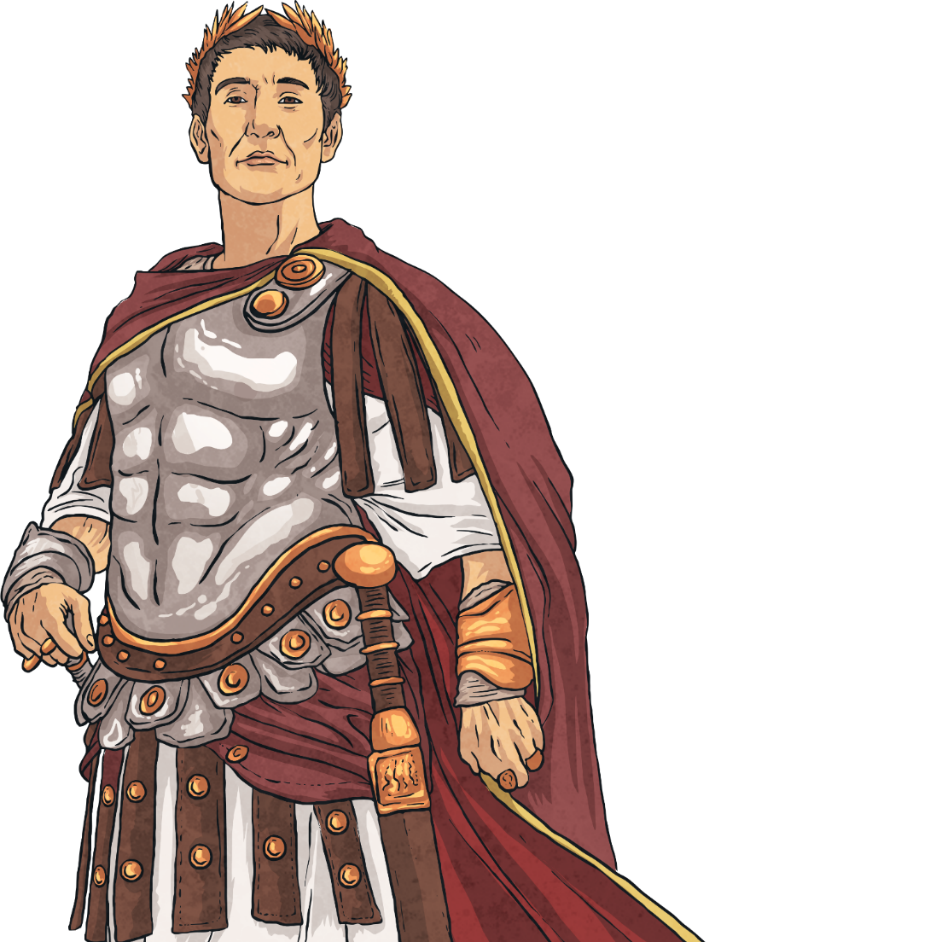
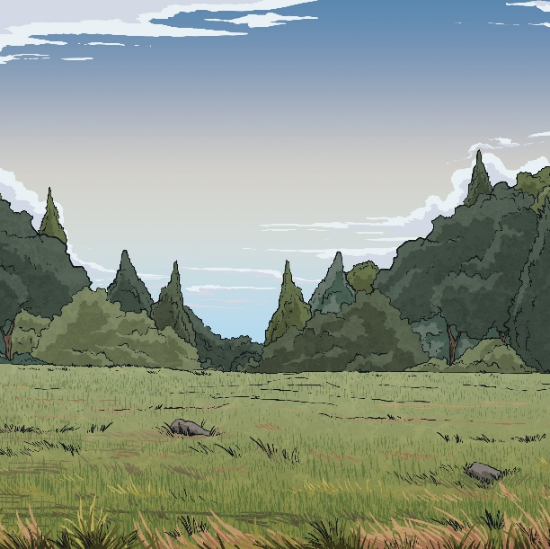
Are There Different Calendars?
Before the year 45BC, we used a calendar based on the cycle of the moon but there were frequent problems with this getting out of sync.
So, Julius Caesar introduced a new calendar named after
him: The Julian Calendar and 45BC was the first New
Year’s Day on the 1st of January.
In 1582, Pope Gregory XIII introduced the calendar we
use today called the Gregorian calendar. This was
based on having a leap year ever four years to keep
the calendar correct.
There are still places in the world and different religions
who use different calendars such as Ethiopia, Iran
and Nepal.
Why not find out the names of as many calendars
as you can that are still used today and what
the differences are.
Find Out More:

Slide 3
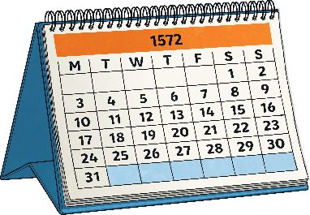
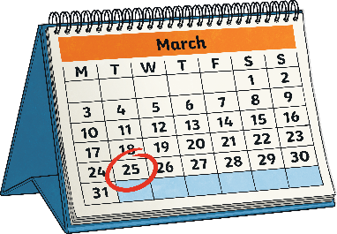
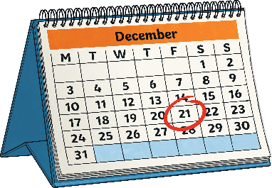
Why January 1st?
In short, Julius Caesar chose the 1st of January in his Julian Calendar because it fitted in with some of their new positions of office but many other dates had been used before that.
Not everyone stuck to the 1st of January. Pope Gregory’s calendar
in 1572 had 1st of January as the start but the spread of this
official date was gradual.
It wasn’t until 1752 that England and parts of America adopted 1st
of January as the New Year, before then it had been 25th March
(around the spring equinox).
Historically and even before Christianity, there were celebrations around the winter solstice and that often marked the start of the
new year.

Slide 4

Who Celebrates New Year First?
Due to the different time zones around the world, there is something called the International Date Line so people around the globe know when to start changing the calendar to the next day.
The International Date Line was created in 1884
It is not| a straight line but runs roughly vertically in the middle of the Pacific Ocean along the end of the map we are used to seeing.
International
Date Line
Think about it: Spot where you live, who celebrates new year before you and after you? Use the + or – hours to work out what are you doing when Mexico or Fiji celebrate New Year.

Slide 5
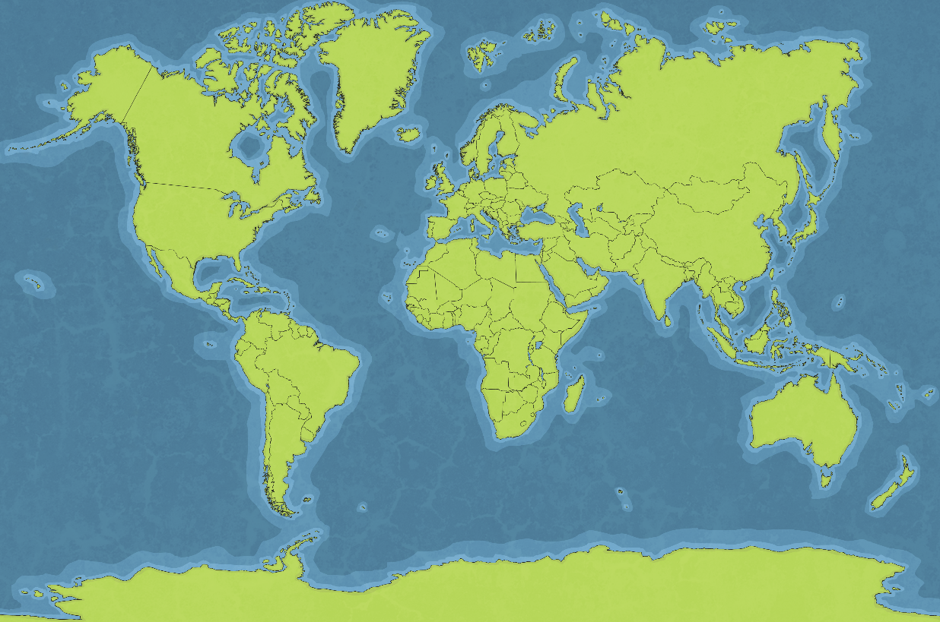
New Year’s Eve Around the World
Due to the different time zones around the world, there is something called the International Date Line so people around the globe know when to start changing the calendar to the next day.
Chinese New Year is later than 1st January. Red is an important colour for
New Year with people giving money in red wallets, hanging red lanterns
and even painting their doors red!
Sydney Harbour Bridge in Australia hosts one of the first huge firework
displays across the world at midnight (their time).
In Japan they celebrate ‘Oshogatsu’ where houses are cleaned and decorated
with bamboo and plum blossom.
A tradition starting in Germany and spreading into other European
countries and further afield, is to watch a short comedy film called
‘Dinner for One’ on New Year’s Eve.
In Chile, people write what they would like to change on a piece of
paper and burn it.
In Spain, people try and eat 12 grapes, one on every chime of midnight.
If you manage it, you will have good luck.
In Louisiana, eating black-eyed-peas and cabbage on New Year’s Day
brings health and wealth for the coming year.
In Denmark, people break plates on the door step of friends, people leave
them out to show how many friends they have.

Slide 6
Hogmanay
This is the Scottish name for the last day of the year and dates back to Viking times with parties around the winter solstice.
Parties are held in homes and in towns and cities, probably the largest of which
is Hogmanay in Edinburgh.
First-Footing is a tradition that starts after the stroke of midnight.
It involves being the first person of the new year to go into a house and with that you bring gifts such as bread, coal, money and whisky to bring good luck for food, drink, wealth and warmth for the year ahead. Traditionally, the person doing the first footing would be the one with the darkest hair and historically
a man.
Find Out More: Try and find to photos or videos of Hogmanay in Edinburgh to see just how big it is!

Slide 7
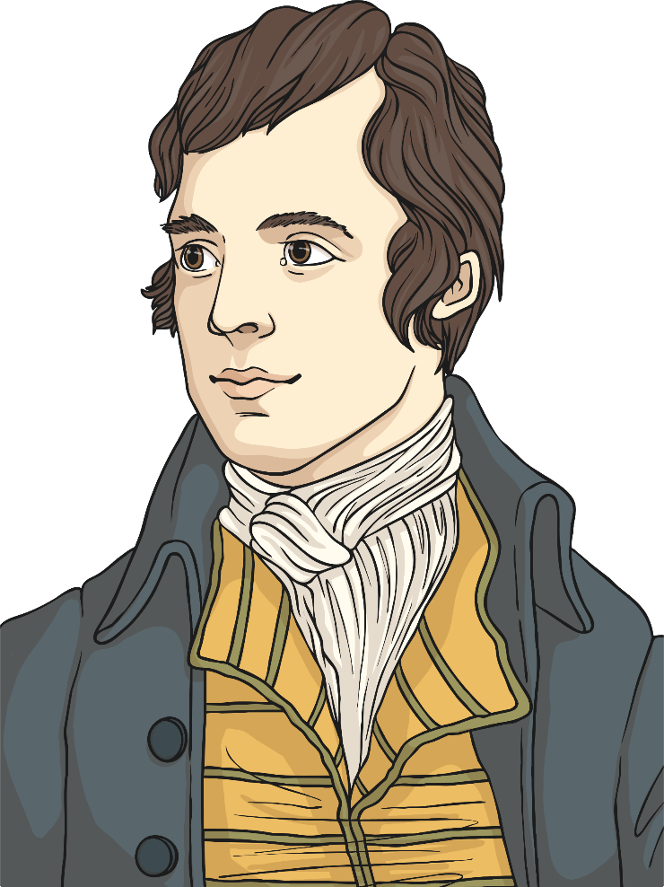
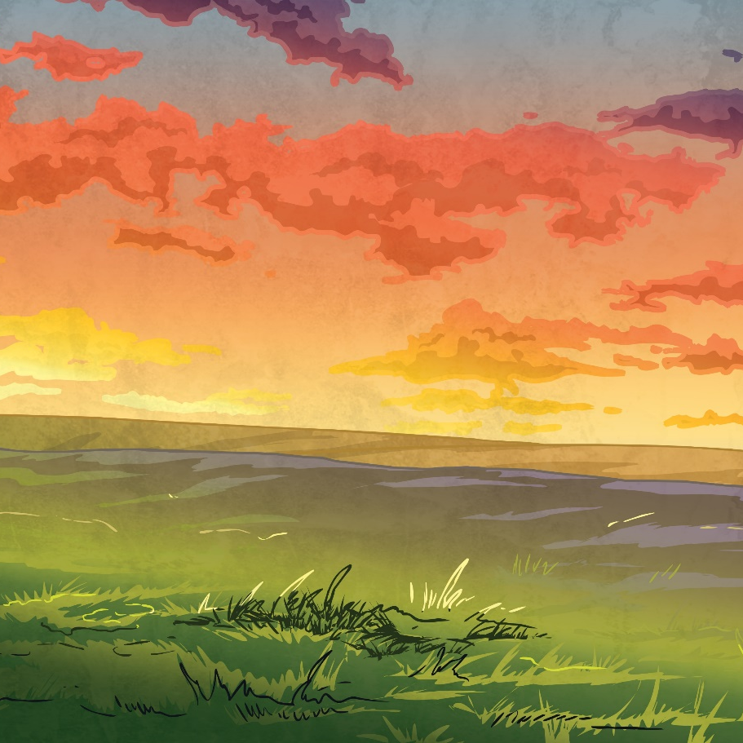
Auld Lang Syne
This is a Scottish song now sung widely across the world at midnight on New Year’s Eve…here’s the first verse and chorus.
Should auld acquaintance be forgot,
and never brought to mind?
Should auld acquaintance be forgot,
and auld lang syne?
  CHORUS:
  For auld lang syne, my dear,
  for auld lang syne,
  we'll tak' a cup o' kindness yet,
  for auld lang syne.

Slide 8
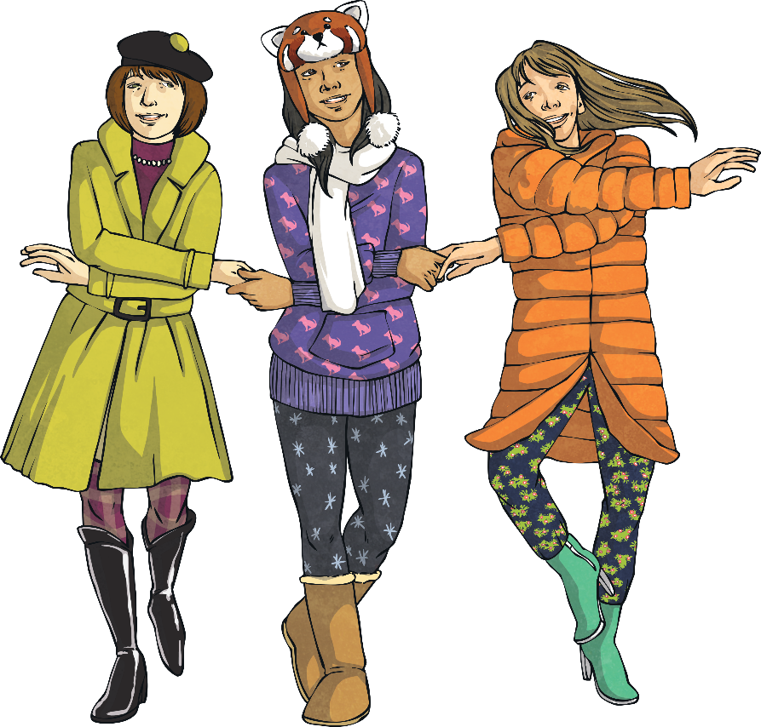
Auld Lang Syne
The song is also used to close other events or at funerals as it is a song to mark the passing of something and at new year it is marking the passing of the old year.
‘for Auld Lang Syne’ means ‘for the sake of old times’ (for old times’ sake we might say), this is why you shouldn’t sing ‘for the sake of auld lang syne’ as you would be repeating yourself.
The words were collected and written by Scottish poet Robert Burns in 1788. It actually has five verses.
Find Out More:Look at all the verses and translate them into modern day English.

Slide 9
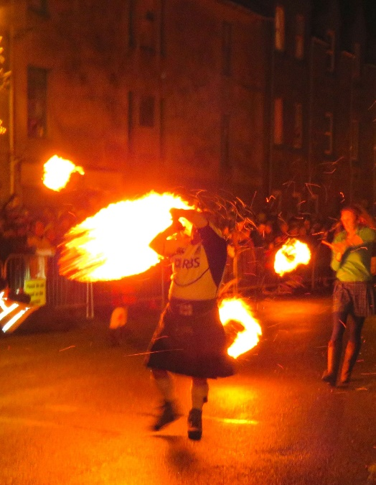
Stonehaven Fireballs
There are various traditions specific to certain places at New Year, but this one is found in Scotland in the town of Stonehaven.
The tradition has been going for over 100 years. Some
say it is to ward off evil spirits and bring luck for the
fishing fleet.
On the stroke of midnight in the town, around 40 people parade down the High Street swinging fire balls to
welcome in the new year.
After the fireball parade, there is a firework display.
Find Out More: Find Stonehaven on a map and then
search for Stonehaven Fireballs on the internet, watch videos and you can even watch the webcam on New Year’s Eve!

Slide 10

New Year’s Resolutions
Starting a New Year signifies a fresh start and people use this to try and make better habits including eating healthily and exercising.
The most common resolution last year in Germany was reducing stress while the Swedish and the UK wanted to get more exercise and the USA wanted to save more money.
People have been making resolutions for a long time. For example, Romans made promises to Janus the god whom January is named after.
In medieval times, knights who were committed to chivalry, made a ‘Peacock Vow’ after Yuletide each year for the coming year.
Try It: Have a go at writing your own resolutions here: New Years Resolution Writing Frame

Slide 11
Things to Do
Reflect and focus on your goals
New Year Activity Booklet
Plan some random acts of kindness for the new year
Play the counting down to the new year board game

Slide 12

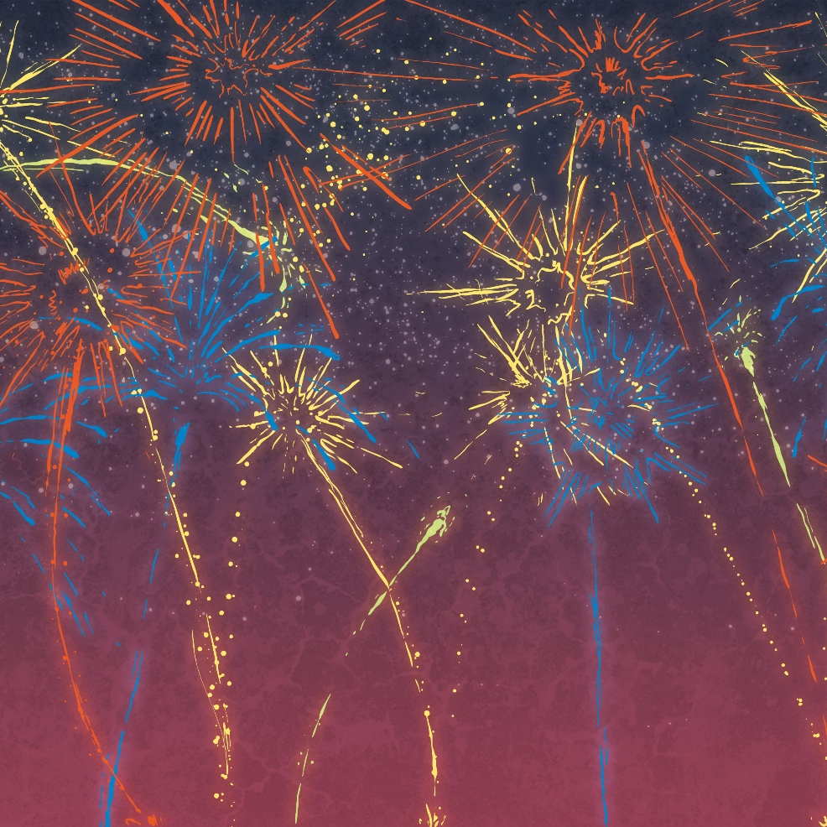
Happy New Year!

